Slide 1
Level 1 Configuration – Own your data model

Slide 2

About the presenter
Anh-Thy Le
Consultant, Planisware
Anhthy.le@planisware.com
Based in San Francisco, CA

Slide 3






Introductions
Companies represented today
Pharmaceutical / Biotech
Oil and Gas
Safety
Telecommunications

Slide 4


Introductions
Name 1 Cool fact about your company
Planisware was spun out of Arianespace

Slide 5

Introductions
Name 1 Cool fact about your company
Planisware was spun out of Arianespace

Slide 6
Introductions
Name 1 Cool fact about your company
Pharmaceutical
Rynita Julien, Biogen
Chris Roenfeldt, Halozyme
Deepthi Kotamraju, Johnson & Johnson
Oil and Gas
Faisal Alshemaimry, Saudi Aramco
Safety
Brian Fisher, MSA Safety
Telecommunications
Shuangjian Yang, Huawei
Wei Ping, Huawei

Slide 7
Agenda (9:00am – 10.30am)
Welcome/Introductions/Check server access
Level 1 Intro
Configuration Page/Tools
User Attributes:
Simple
Possible Values
Relations
Named Formulas
Hyperdoc
Settings

Slide 8
Introduction
What is Level 1 configuration ?

Slide 9
What is Level 1 configuration ?
With V6 release, Planisware has improved full customization using only Intranet
Pros
Done on intranet (not in Pro anymore) in simple administration menus
Cons
No access to all environment objects, specially advanced ones
Large number of objects now available in 6.2 : simple data-model extension (attributes, list of values, ring attributes), attribute settings, alerts, locks, symbolic fields, data management rules, customization of entry screens, code generator, iterative formula, workflows, indicators…
Do not requires extensive Planisware expertise
No access to script
No heavy data model extension

Slide 10
Exercise
Open your browser and surf to the L1 training server:
URL: https://l1training.planisware.com/
Usernames:
Attendee | Login User Name
Brian Fischer | BRIAN_FISCHER
Chris Roenfeldt | CHRIS_ROENFELDT
Deepthi Kotamraju | DEEPTHI_KOTAMRAJU
Faisal Alshemaimry | FAISAL_ALSHEMAIMRY
Rynita Julien | RYNITA_JULIEN
Shuangjian Yang | SHUANGJIAN_YANG
Wei Ping | WEI_PING
Password = username+”1”

Slide 11
The configuration page
Managing configuration tools
User attributes
Attribute settings
Data management rules
Indicator bars

Slide 12
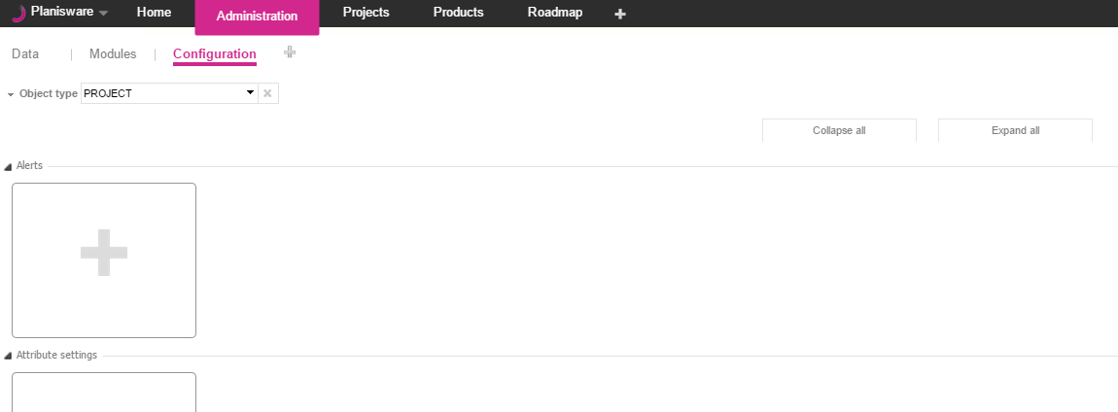
About the configuration page
In Planisware V6, it is possible to configure each object type by creating alerts, attribute settings, customizable reports, data management rules, locks and user attributes. For the projects, it is also possible to configure the Indicator bars.
To configure object types:
Go to the Administration module.
Add the Configuration page.
Select an Object type.

Slide 13
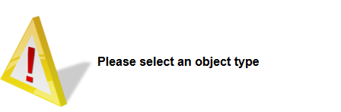
About the configuration page
It is mandatory to select an object type. If Object type has not been selected, a warning message is displayed.
Once an object type has been selected, all the objects of a same class are displayed on a same page.
Objects are saved in the dedicated common dataset initialized when restoring a dpe: CONFIG_L1_COMMON_FILE (ADM > Settings)
That file is not overwritten when importing a dpe.

Slide 14
Exercise
Add the Administration module tab and the Data and Configuration tabs

Slide 15
Managing configuration tools
(De)activating configuration tools
Modifying configuration tools
Deleting configuration tools

Slide 16
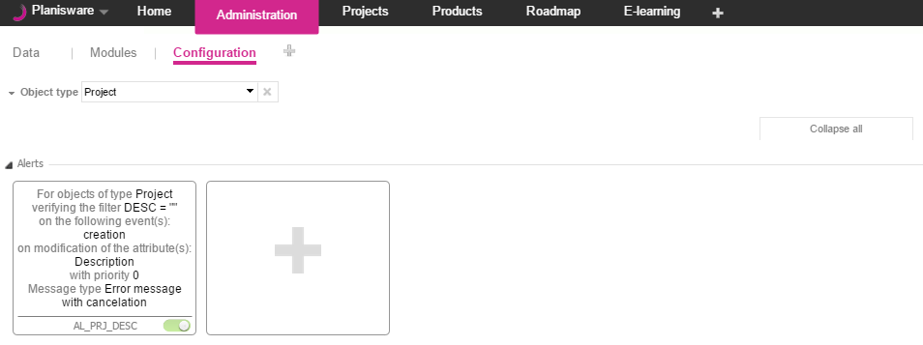
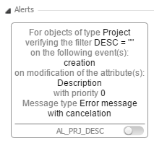
(De)activating configuration tools
Click to activate or deactivate a tool.

Slide 17
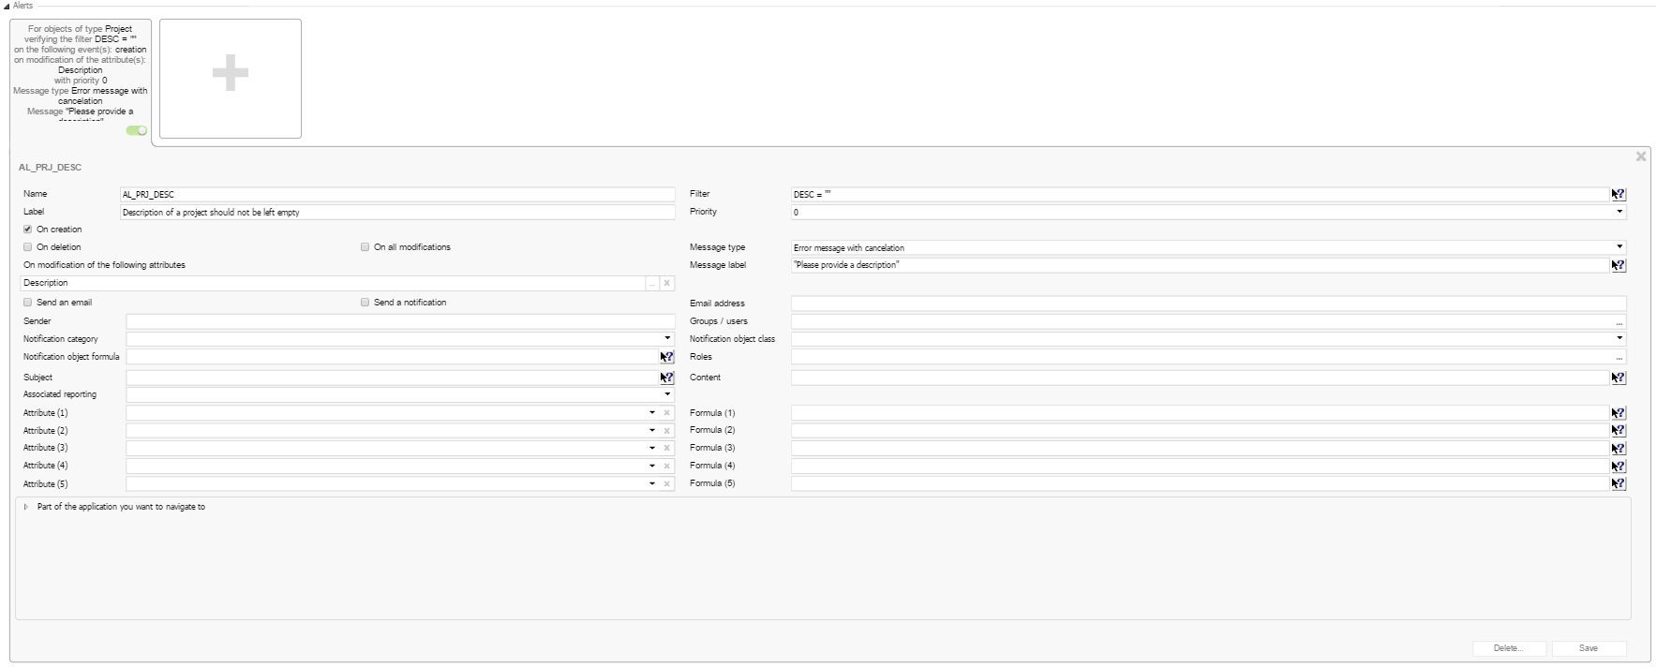
Modifying configuration tools
To modify a configuration tool:
Click on a tool.
Modify your data.
Click Save.

Slide 18
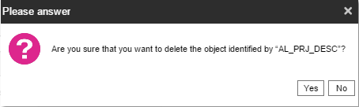
Deleting configuration tools
To delete a configuration tool:
Click on a tool.

Slide 19
Meet your PM Head

Slide 20
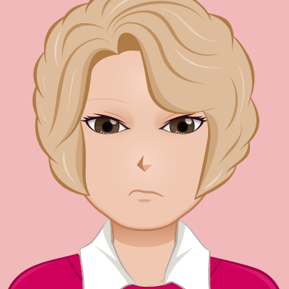
Meet Pam, the Head of Project Management
Our data model and KPIs are always changing! We need a system that is as robust as our organization!
I want the system to perform simple calculations so I do NOT have to!
There are so many attributes to keep track of, and we need end users to understand the purpose of each one!
We need more control over extending our data model!

Slide 21

User Attributes - Scenario
Scenario
We need a new character code for projects to describe the risk level. We should also have a difficulty level number for each activity within the project!

Slide 22
User Attributes - Scenario
Scenario
We need a new character code for projects to describe the risk level. We should also have a difficulty level number for each activity within the project!
1
1
Analysis
User attributes allow you to create additional attributes on a given class which is perfect for when your manager wants to track more and more information within Planisware.
How to break down the situation: 1. Figure out relevant classes - Project, Activity
1

Slide 23
User Attributes - Scenario
Scenario
We need a new character code for projects to describe the risk level. We should also have a difficulty level number for each activity within the project!
2
1
2
1
Analysis
User attributes allow you to create additional attributes on a given class which is perfect for when your manager wants to track more and more information within Plansiware.
How to break down the situation: 1. Figure out relevant objects - Project, Activity 2. Determine the type of data needed - Character, Number
1
2

Slide 24
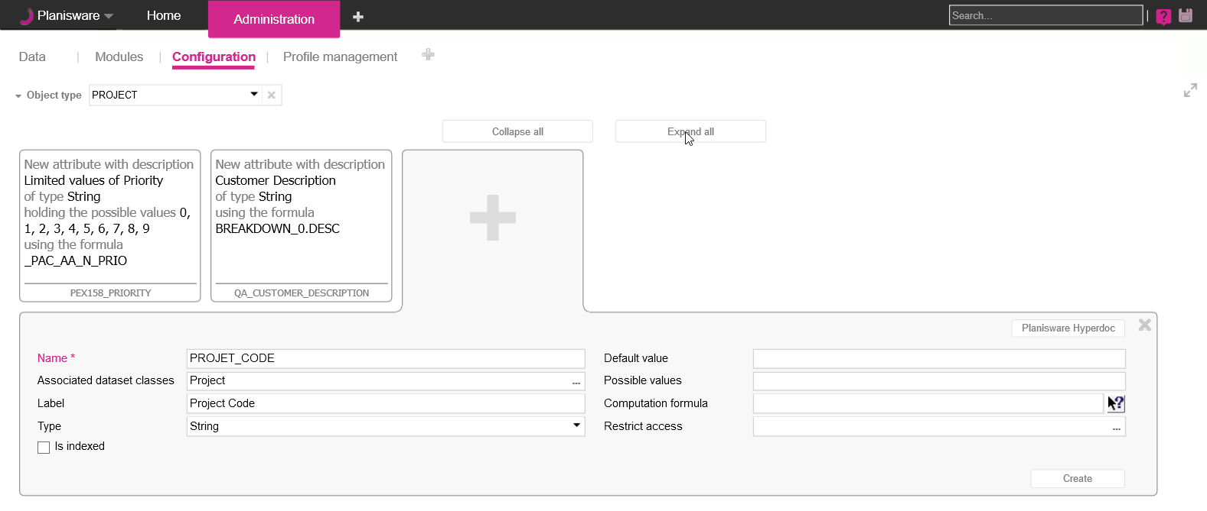
User Attribute Creation
1
2
3
4
Select the relevant object from the analysis
Click on the + button of the user attribute section to create a new user attribute
Give your attribute an appropriate Name and Level
Name – Check with your admin to see if you have a naming convention to use
Label - Use a description that makes it easy for end users to understand
Select the correct Data Type from the analysis
Default value of attribute when an object is created
1
2
3
4
5

Slide 25
User Attribute Creation – Project Code
1
2
3
4
Select the relevant object from the analysis
Click on the + button of the user attribute section to create a new user attribute
Give your attribute an appropriate Name and Level
Name – Check with your admin to see if you have a naming convention to use
Label - Use a description that makes it easy for end users to understand
Select the correct Data Type from the analysis
Default value of attribute when an object is created
1
2
3
4
5

Slide 26
Exercise
Create your own Project code user attribute:
Name = XX_UA_S_PROJECT_CODE (where XX are your initials)
Convention: 3 Letters of your company
Label = XX Project code
Type = String
Go to the Project module and insert your attribute in the Projects table
Fill out the attribute for a few projects

Slide 27
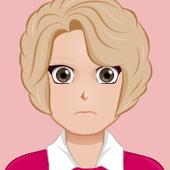
User Attributes - Scenario
Scenario
Thank you for adding the attribute to the project! Don’t forget that I also needed a difficulty level number for each activity within the project!
Analysis
User attributes allow you to create additional attributes on a given class which is perfect for when your manager wants to track more and more information within Plansiware.
How to break down the situation: 1. Figure out relevant objects - Project, Activity 2. Determine the type of data needed - Character, Number
1
2

Slide 28
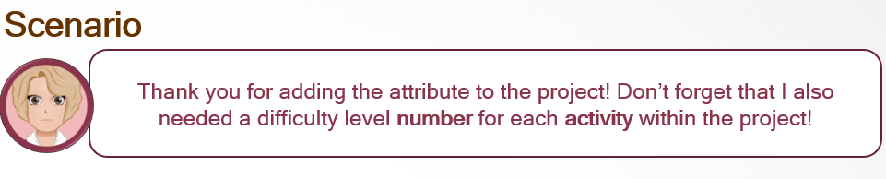
Exercise
Create your own user attribute based on the above scenario:
Remember the following – Naming convention
Class
Type

Slide 29
User Attributes - Scenario
Scenario
The new project code works great! The difficulty level for activities needs improvement, though. Too many users are entering different values and it is confusing all the PMs. Can we have a dropdown selection for difficulty levels between 1-5 and only have PMs be able to view and edit this attribute?
1
2
Analysis
How to break down the situation: 1. Using Possible Attribute Values will limit user input to a set of specified values. There are 2 ways of implementing this feature.
2. Setting the restrict access value of a user attribute lets admins control which users or which user groups can view the user attribute within the system
1
2

Slide 30
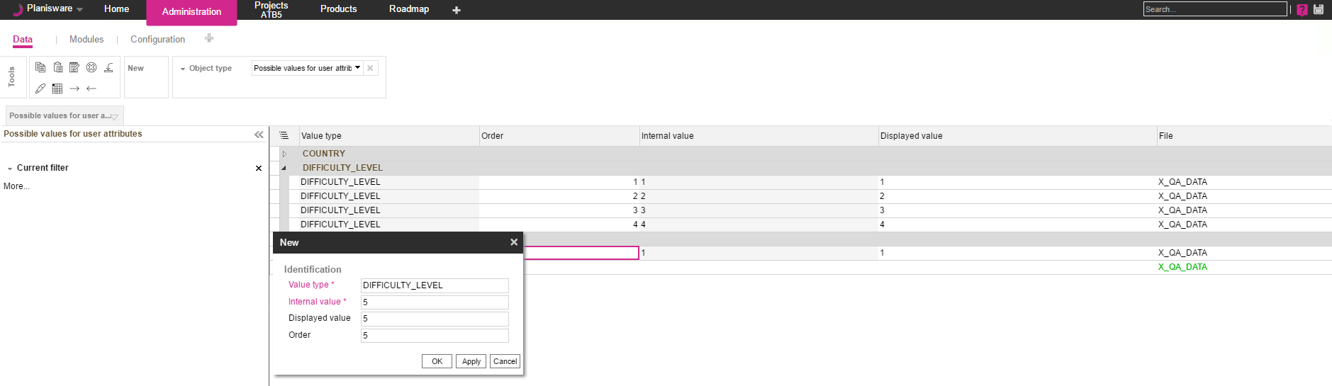
Possible attribute values table
1
4
2
3
Planisware has an OOB Administration Table that maintains lists of possible values. First go to the Administration Module -> Data Page and select Possible values for user attributes as the object type
Clicking on the “New” tool allows admins to create a new “Possible Value” entry. Value choices are grouped into value types.
Possible Value lines can have the following attributes defined:
Internal value – The value stored in the database
Displayed Value - The value displayed in a table or in reports Order - The order the possible value is displayed
All of the Possible values for Difficulty Level can be seen in the table
1
2
3
4

Slide 31
Exercise
Create a dropdown list for your own user attribute:
Go to administration -> Data and select ‘Possible values for user attributes’ object type
Create three values:
Value type = XX_DIFFICULTY_LEVEL
Internal value = Low, Medium and High
Displayed value = Low, Medium and High
Assign the possible values type to a new project user attribute:
Name = XX_UA_S_DIFFICULTY_LEVEL
Label = XX Difficulty level
Type = XX_DIFFICULTY_LEVEL
Test the attribute and possible values dropdown from the Project module

Slide 32
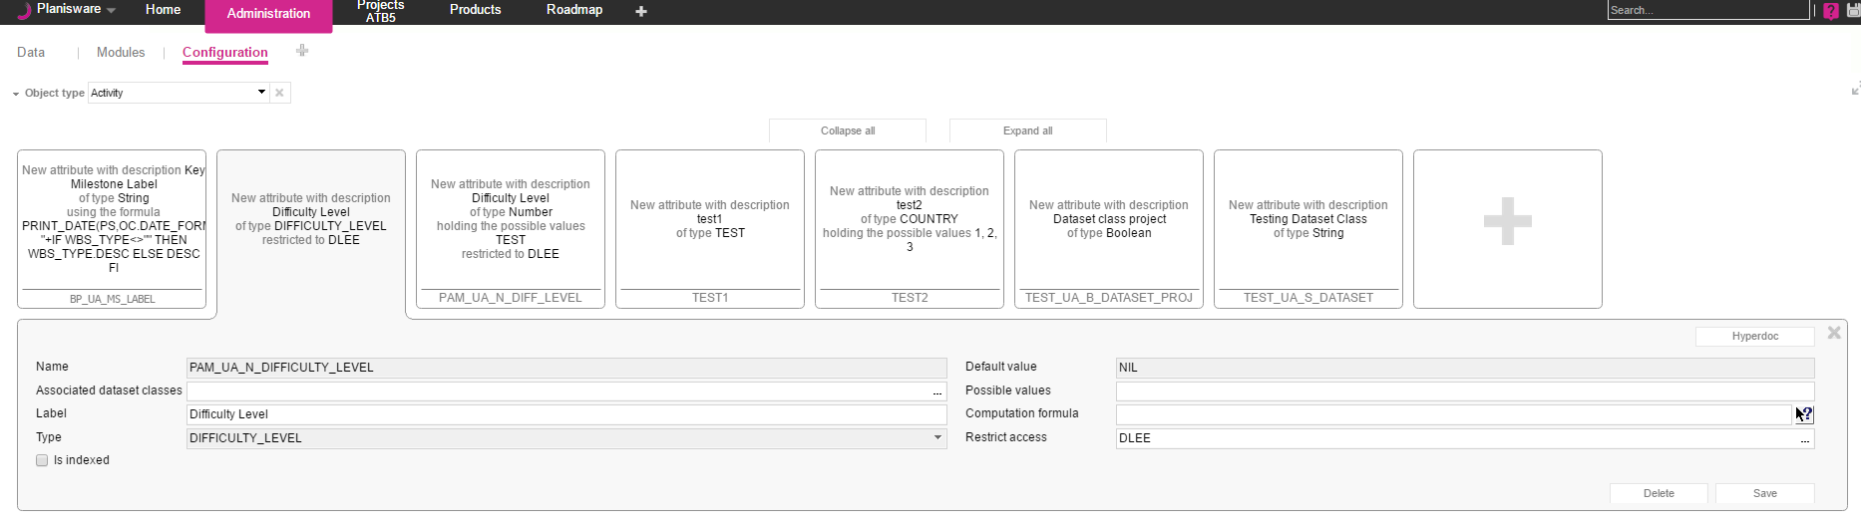
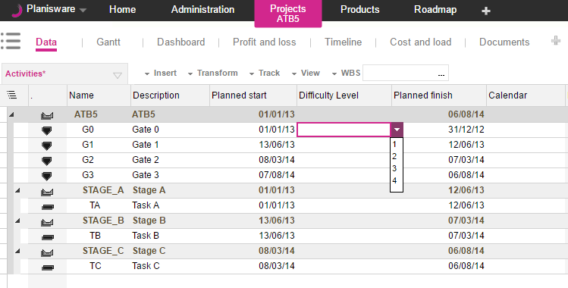
User Attributes – Possible Values
Administration:
1
Activity Table:
A new user attribute’s type can be set to an existing value type
The dropdown choices display all possible values of the value type in the right order
1
2

Slide 33

User Attributes - Relations
Scenario
Wow this is great! I can add a lot of different data types to our model now! What if we want to link two existing classes? We have a situation! We already associate resources with skills, but there is no relationship between activities and skills. To make things more complicated, some activities need to be associated to multiple skills!

Slide 34
User Attributes - Relations
Scenario
Wow this is great! I can add a lot of different data types to our model now! What if we want to link two existing classes? We have a situation! We already associate resources with skills, but there is no relationship between activities and skills. To make things more complicated, some activities need to be associated to multiple skills!
Analysis
When you need to add attributes that represent more than simple data types such as strings, numbers, and dates, but classes, this is called a relation. Relational Attributes define a relation between 1 object to another. If there is a need to map to multiple objects in a given attribute, this is called a ring attribute.

Slide 35
User Attributes - Relations
Scenario
Wow this is great! I can add a lot of different data types to our model now! What if we want to link two existing classes? We have a situation! We already associate resources with skills, but there is no relationship between activities and skills. To make things more complicated, some activities need to be associated to multiple skills!
1
3
Analysis
When you need to add attributes that represent more than simple data types such as strings, numbers, and dates, but classes, this is called a relation. Relational Attributes define a relation between 1 object to another. If there is a need to map to multiple objects in a given attribute, this is called a ring attribute.
How to break down the situation: 1. Determine which objects define the relation: activities and skills
Determine the relation direction. This will decide which object type should be configured: an Activity should list skills so the activity object should have an attribute to skills Determine if we need a relation or a ring attribute : ring attribute
1
2
3

Slide 36
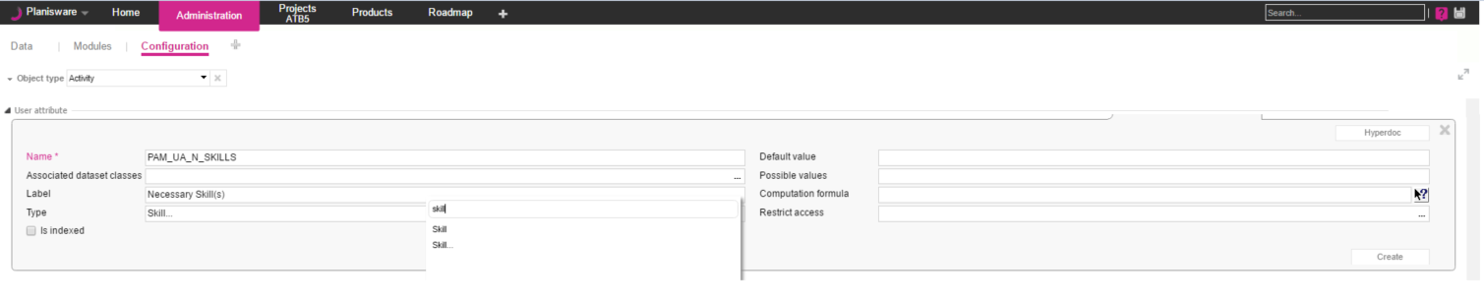
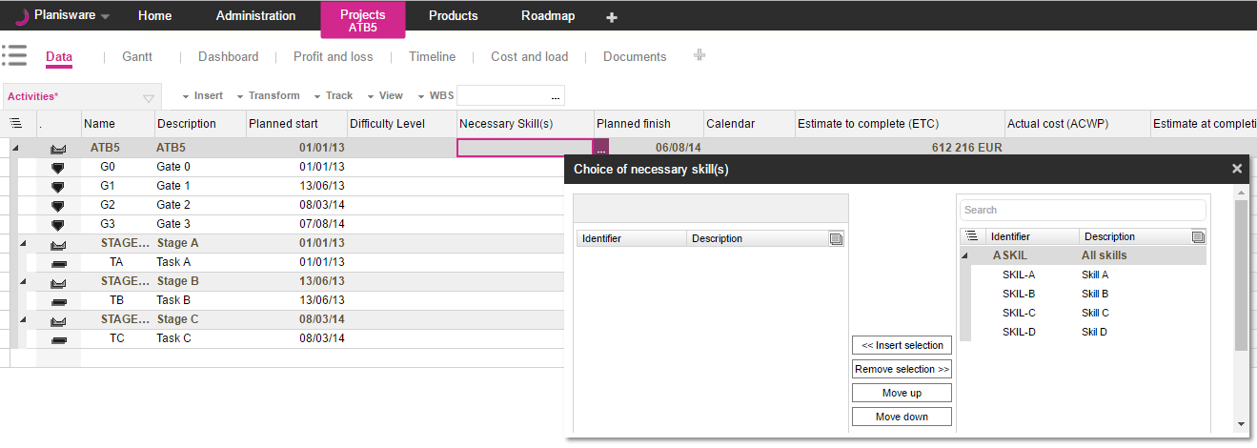
User Attributes – Relations
Administration:
1
Activity Table:
2
The Type of an administration can be set to a different class. Note that classes might have the “…” after. The “…” determines if the relation should be a ring attribute
The choices display all possible values of the value type in the right order
1
2

Slide 37
Exercise
Scenario
We need to know the primary skill associated with an activity. Also we need to know all other skills that are associated with an activity. Can we extend the data model to meet this?
Create the appropriate data model extensions
Name = XXX + ”UA_PRIMARY_SKILL”
Name = XXX + “UA_SKILLS” XXX = name of company + initials
Test the attribute and possible values dropdown from the Project module

Slide 38
User Attributes – Named Formulas
Scenario
Its nice to know that we can extend our data model to include everything from simple data to all types of relational data! What if we need to perform some calculations? We want to have a simple project prioritization based on multiplying a project’s Difficulty level, Importance, Cost, and Leverage

Slide 39

User Attributes – Named Formulas
Scenario
Its nice to know that we can extend our data model to include everything from simple data to all types of relational data! What if we need to perform some calculations? We want to have a simple project prioritization based on multiplying a project’s Difficulty level, Importance, Cost, and Leverage
1
2
3
Analysis
Named formulas can be used to perform a wide range of calculations and data transformations. The things to look for in a named formula are Class: Project Type : Since we are multiplying several digits we expect our type to be a number
Evaluation Formula: We will be multiplying the values of Difficulty Level, Importance, Cost, and Leverage .
Note: Named Formulas can perform a wide variety of calculations that are out of scope of this class. If you would like to learn more, please inform the trainer asking about in depth training on formulas and what they can do

Slide 40
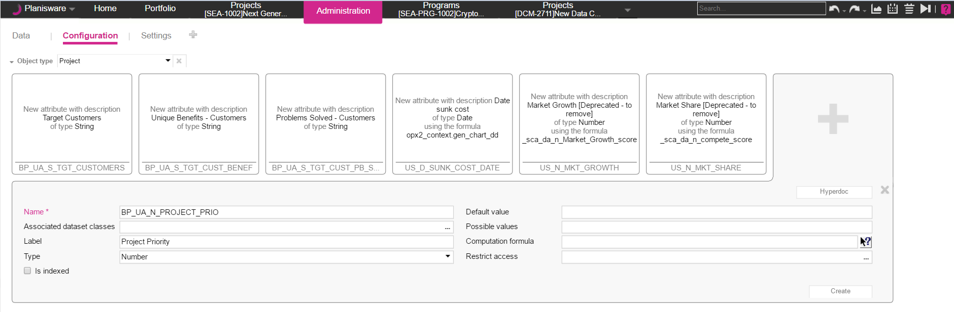
Data model extension: named formula
Select the Object Class of the Named Formula Select the name, Label, and return Type of the Named Formula Click on the icon next to the computation formula to open up the formula builder form
1
2
3
1
3
2

Slide 41
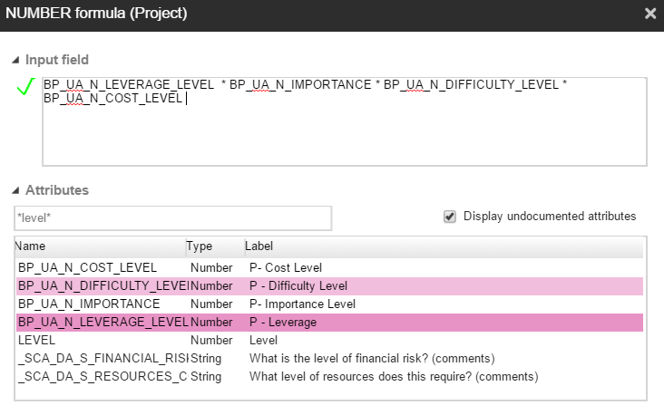
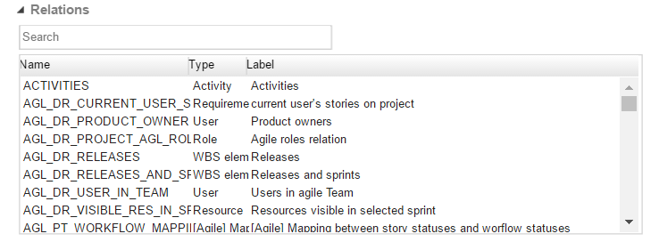
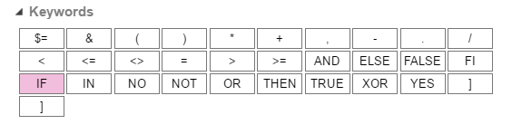
Data model extension: named formula
The Input field specifies the actual named Formula calculation
Use the attributes section to search for all attributes available on your selected class. Note that is is best practice to use the search feature
Use the relations section to search for all other classes the current class is connected to
The keywords section lists available syntax offered by Named Formulas
1
1
2
2
3
3
4
4

Slide 42
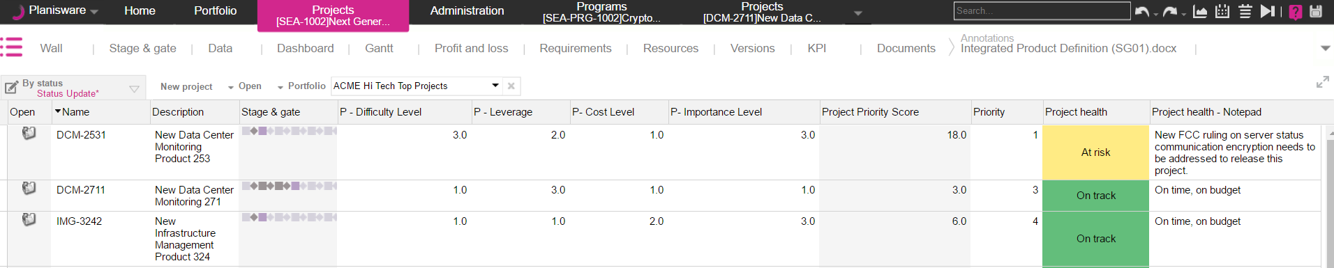
Data model extension: named formula

Slide 43
Exercise
Create a new user attribute and use a named formula to calculate its value:
Name = XX_UA_S_DIFFICULTY_FACTOR
Label = XX Difficulty factor
Type = XX_DIFFICULTY_LEVEL
Computation formula =
IF XX_DIFFICULTY_LEVEL = "Low" THEN 1 ELSE IF XX_DIFFICULTY_LEVEL = "Medium" THEN 2 ELSE 3 FI FI
Test the attribute and possible values dropdown from the Project module

Slide 44
Demo
name formula common tasks
equality
non equality <>
concat string (+)
.
from("")
AND , OR
>, <
DATE_OF_THE_DAY
using the relations part of the builder

Slide 45
User Attributes - Hyperdoc
Scenario
Our Data Model is expanding so much! How are end users expected to know details about each of our attributes? Is there any way to help guide and teach end user about user attributes we create? Lets take the last Project Priority Score for example. Can we explain to end users how it is calculated?

Slide 46
User Attributes - Hyperdoc
Scenario
Our Data Model is expanding so much! How are end users expected to know details about each of our attributes? Is there any way to help guide and teach end user about user attributes we create? Lets take the last Project Priority Score for example. Can we explain to end users how it is calculated?
1
2
Analysis
Hyperdoc is a new feature within Planisware to allow admins help end users know more about their data. This new feature allows end users hover over attributes to get more insight on attributes as determined by the system admin.
First you need to know: 1) The Attribute you wish to document 2) What information you want to convey
1
2

Slide 47
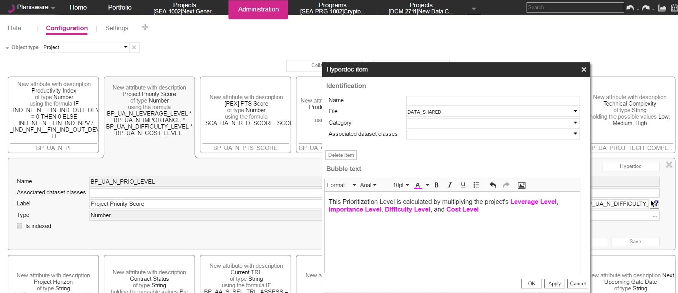
Data model markup - Hyperdoc
1
3
2
Find the attribute you wish to document
Click on the Hyperdoc button associated to the attribute
Add in the bubble text any rich text information you would like to convey to end users
1
2
3

Slide 48
Data model markup - Hyperdoc
1
2
3
Find the attribute you wish to document
Click on the Hyperdoc button associated to the attribute
Add in the bubble text any rich text information you would like to convey to end users
1
2
3

Slide 49
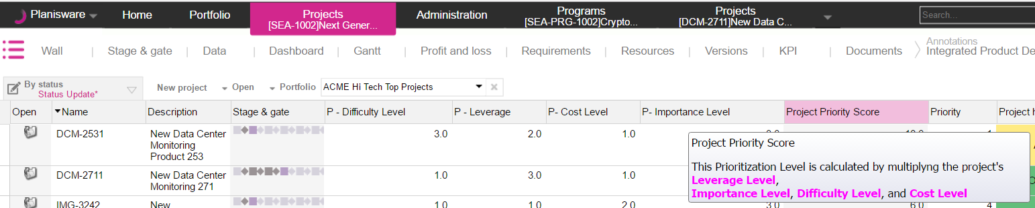
Hyperdoc

Slide 50
Attribute Settings
Scenario
Can we have more control over attributes? For example we do not want end users to be able to add sales information to their project tables. Also, our European counterparts are fed up with seeing some European milestone dates in the American Format. Lastly, we need to be able to set default values. For example a project’s default description should be “Please fill me out” so users do not forget to provide a description
Analysis

Slide 51
Attribute Settings
Scenario
Can we have more control over attributes? For example we do not want end users to be able to add sales information to their project tables. Also, our European counterparts are fed up with seeing some European Start dates in the American Format. Lastly, we need to be able to set default values. For example a project’s default description should be “Please fill me out” so users do not forget to provide a description
1
1
1
Analysis
Attribute Settings allow admins to hide attributes from table insertion, set default formats, and set default values.
For this configuration an admin needs to know: The Attributes they wish to control : Sales, European Start, Description Control Definitions: Sales – Should be hidden European Start - Should be in format DD-MM-YYYY
Project Description – Should default to “Please fill me out”
1
2

Slide 52
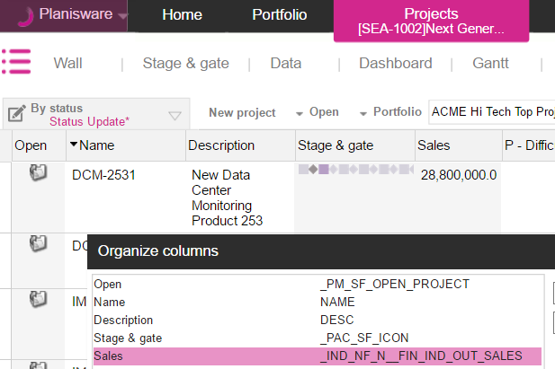
Attribute Settings – Hiding in Intranet Server
1. Find the attribute on which you want to limit information. It will help to take note of the internal nickname

Slide 53
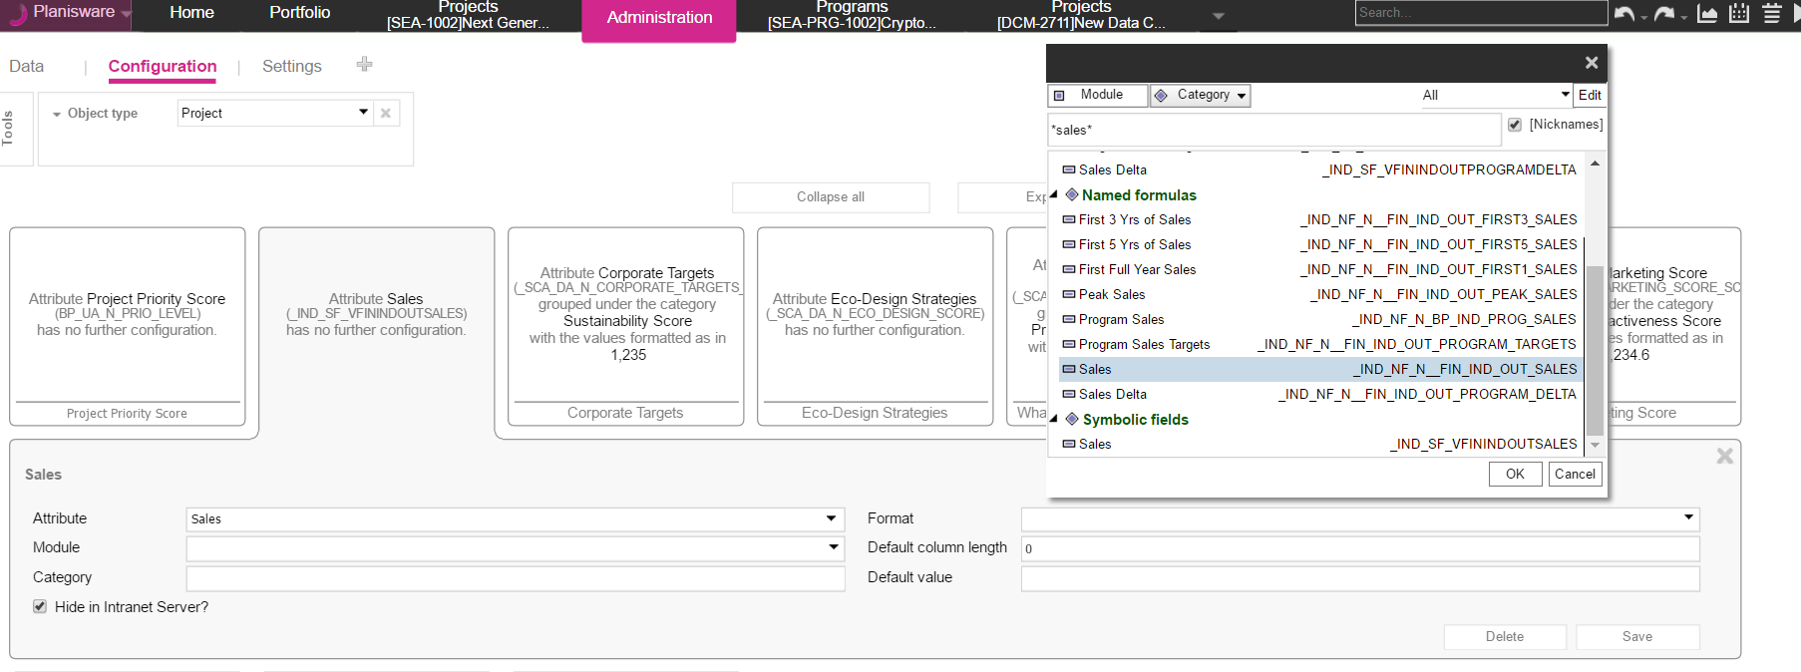
Attribute Settings
1
2
3
4
Select the correct class of the attribute you wish to limit
Find the exact Attribute for the attribute setting using the nickname
Mark hide in intranet Server After clicking Save, this attribute will no longer be available for insertion, however if the attribute is already on a table, this flag will not remove the attribute from the style
1
2
3
4

Slide 54
Exercise
Choose a user attribute you created
Verify that you can insert the attribute to a table
If the attribute it on the table, remove the attribute from the table
Hide the attribute
Verify that the attribute is no longer available for selection

Slide 55
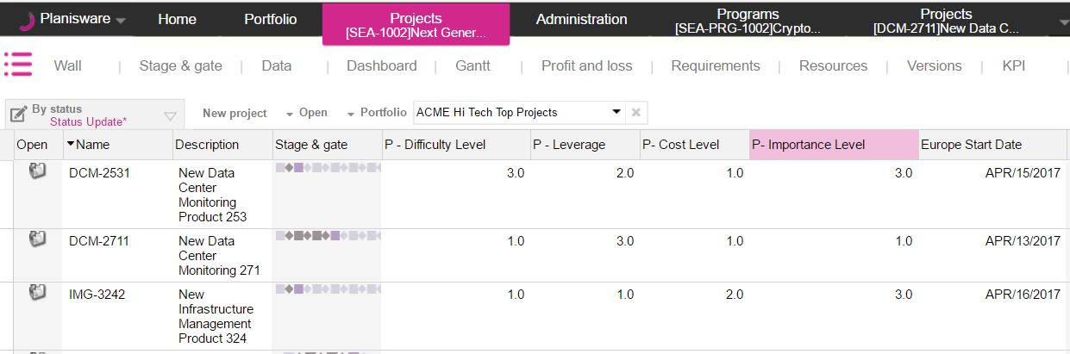
Attribute Settings – Default Date Format
1. Find the attribute on which you want to limit information. It will help to take note of the internal nickname

Slide 56
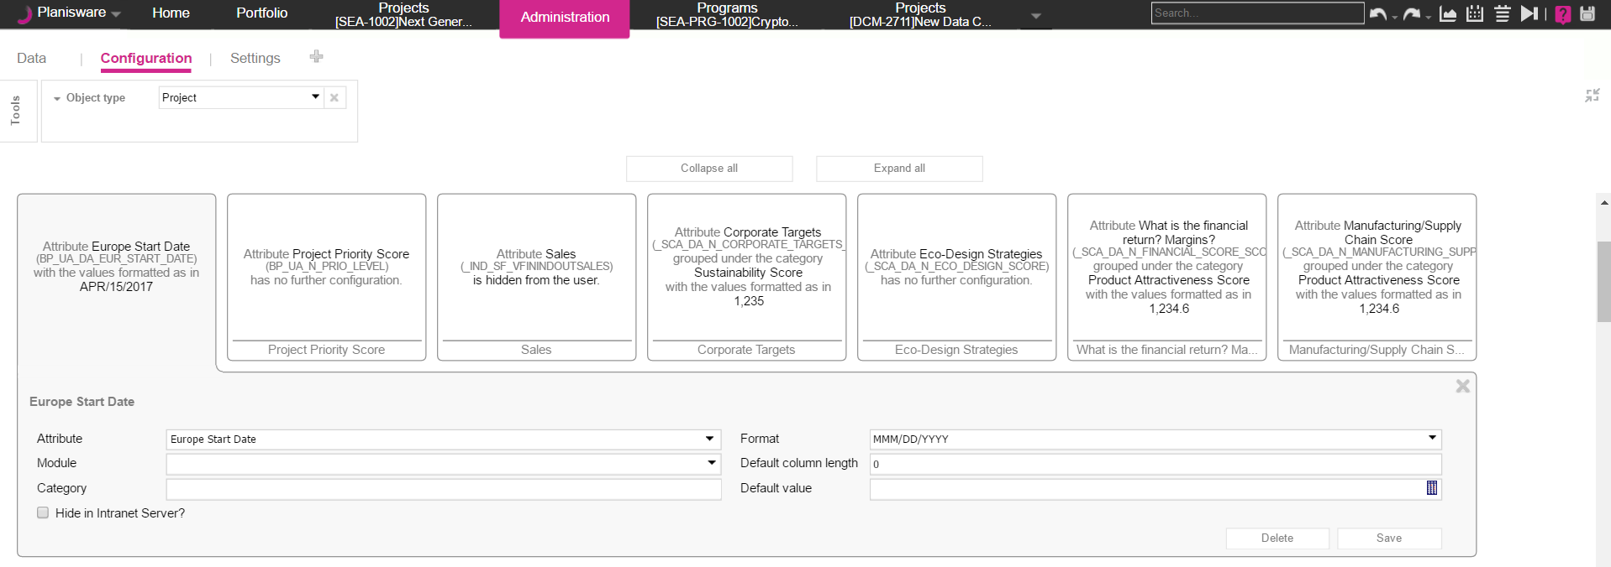
Attribute Settings
1
2
3
4
Select the correct class of the attribute you wish to limit
Find the exact Attribute for the attribute setting using the nickname
Set the Format (this picklist is dynamic based on the type of attribute) After clicking Save, this attribute will by default display in the attribute setting format
1
2
3
4

Slide 57
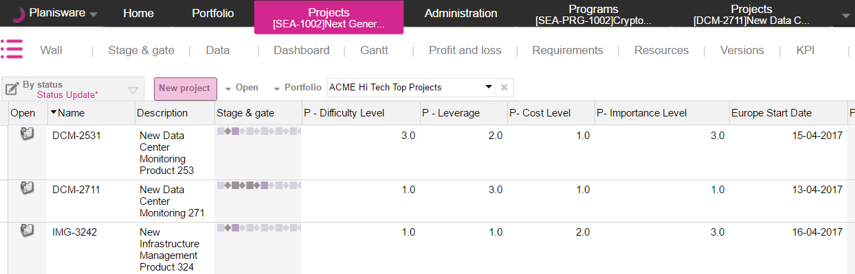
Attribute Settings – Default Date Format

Slide 58
Exercise
Create a new Date Type User attribute on Project
Set the default Date format of this attribute to “MM-DD-YYYY”
Verify that the Date format is enforced

Slide 59
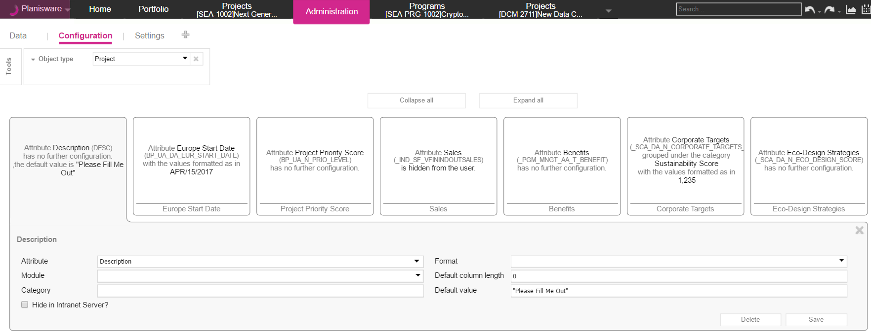
Attribute Settings
1
2
3
4
Select the correct class of the attribute you wish to limit
Find the exact Attribute for the attribute setting using the nickname
Set the Default Value After clicking Save, this attribute will by default display in the attribute setting format
1
2
3
4

Slide 60
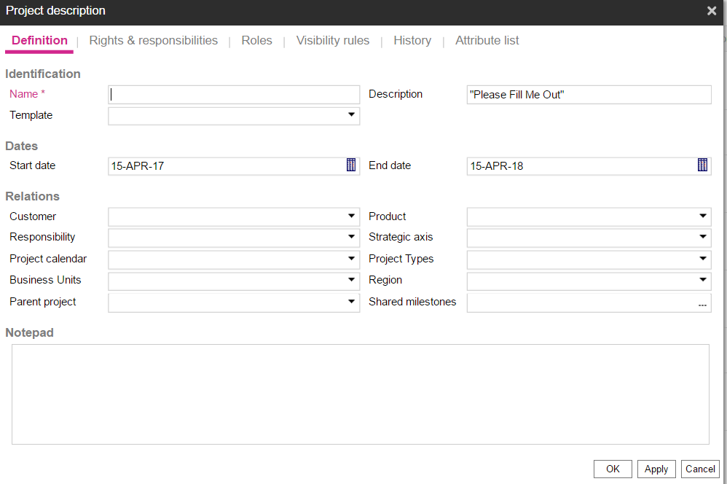
Attribute Settings – Default Value on Project Creation Popup

Slide 61
Exercise
Create a new String User Attribute with a default value of “Please change me” on class activity
Create a new activity on a project
Verify the default value of the new attribute

Slide 62
Meet Pam, the Head of Project Management
User Attributes
Named Formulas
Our data model and KPIs are always changing! We need a system that is as robust as our organization!
I want the system to perform simple calculations so I do NOT have to!
There are so many attributes to keep track of, and we need end users to understand the purpose of each one!
We need more control over extending our data model!
Hyperdoc
Attribute Settings

Slide 63
Questions

Slide 64
Level 1 Configuration - Usability

Slide 65
Agenda (10:30am – 12:00pm)
Color Management
Image Management
Indicators
Attribute Chooser Style
Working Lunch (noon-1pm)
Styles
Text Keys
Toolbar Editor
E-learning

Slide 66
Meet your Usability Lead

Slide 67
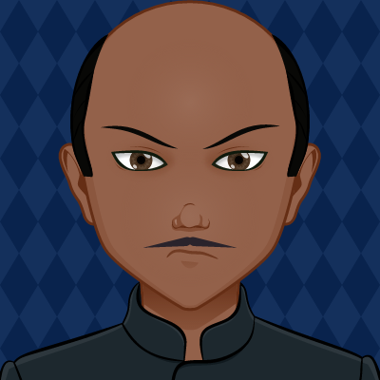
Meet Ajay, the Head of Usability
With so much data coming in, we need to make it more presentable and meaningful!
We need thorough methods to highlight important information!
The number of attributes is overwhelming and I don’t want to see them all the time!
We need to make it easier for our users to navigate the application!

Slide 68

Color management- Scenario
Scenario
Our company likes to color code specific activities. Is there a way to categorize activities visually, so that some activity types that have the description “Testing” can stand out in the Gantt chart?

Slide 69
Color management- Scenario
Scenario
Our company likes to color code specific activities. Is there a way to categorize activities visually, so that some activity types that have the description “Testing” can stand out in the Gantt chart?
1
2
Analysis
Leverage color management to set specific graphical properties on Gantt elements that apply to all projects.
How to break down the situation: 1. Break down activity types and choose a color or symbol to represent them 2. Create a new color rule with an icon or symbol and color that can be viewed on the Gantt screen

Slide 70
Color Management
Creating new colors rules
Colors in Gantt rendering

Slide 71
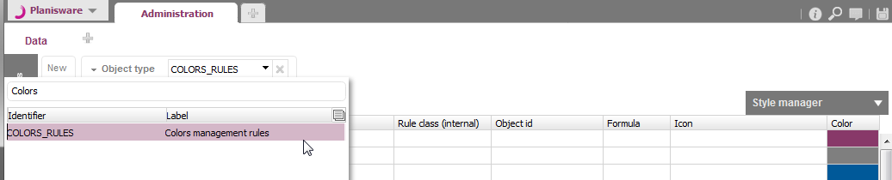
Creating new colors rules
To create a new color rule navigate to the Administration > Data page.
In the Object type field select Colors rules to display the Colors management rules table.
Click the New button to display the Colors management rules creation dialog.

Slide 72
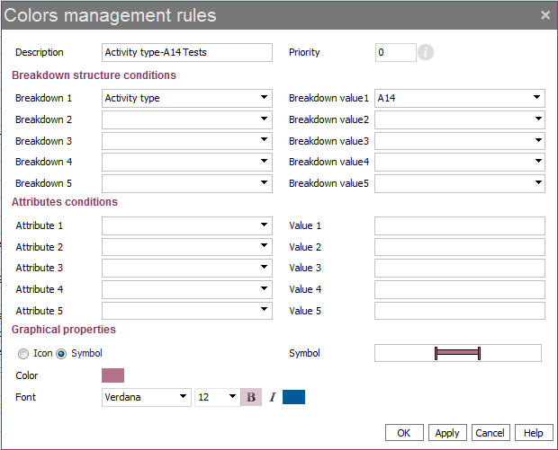
Creating new colors rules
1. Enter a Description.
Name is automatically created and corresponds to the object ONB.
2. The rule with the lowest priority will be applied first.
4. Select the Breakdown structure value on which you want to apply the rule (e.g. activity type A14)
3. Select the Breakdown structure on which you want to apply the rule.
Here, the rule will be applied on an activity type.
5. Select a Shape and a Color for the element of the Gantt representing this activity.
The defined Font will be applied in the table.

Slide 73
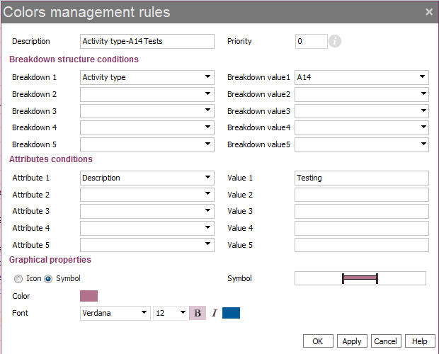
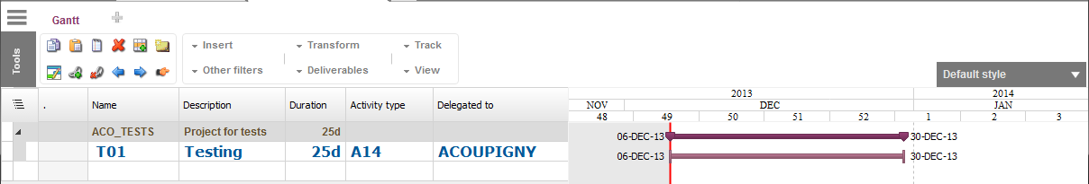
View in Gantt
Rule definition
Ex. With symbol
The rule is only applied on activity of type A14 which Description is Testing.
Result: Rule rendering in Gantt

Slide 74
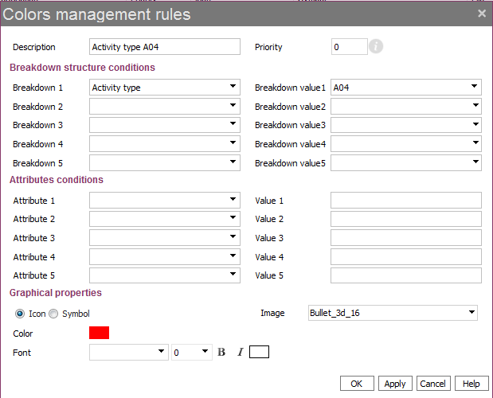
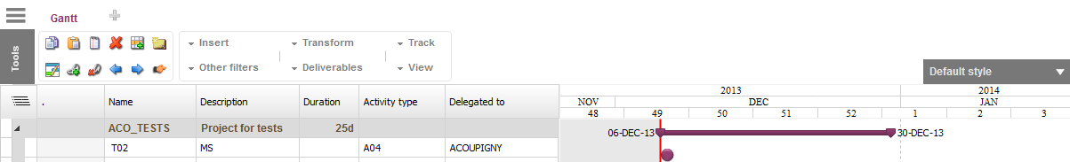
View in Gantt
Rule definition
Ex. with Icon
The rule is only applied on activity of type A04.
Rule rendering in Gantt

Slide 75
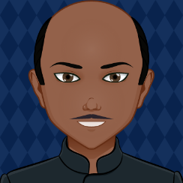
Image management - Scenario
Scenario
While the colors are working great for the activities, is there a way to add more visual elements on the list of projects or even status reports? Can we include more meaningful symbols for projects displaying
project health to show projects meeting targets and those that need attention (i.e. comparing EAC vs. BAC values)?

Slide 76
Image management - Scenario
Scenario
While the colors are working great for the activities, is there a way to add more visual elements on the list of projects or even status reports? Can we display more meaningful symbols for project health to show projects meeting targets and those that are not in the right direction (i.e. comparing EAC vs. BAC values)?
3
1
2
Analysis
Utilize new image management features to add a column on the Projects table.
How to break down the situation: 1. Import images into the image bank
2. Add a new symbolic field “Project Health” using these images
3. Display status reports for each project

Slide 77
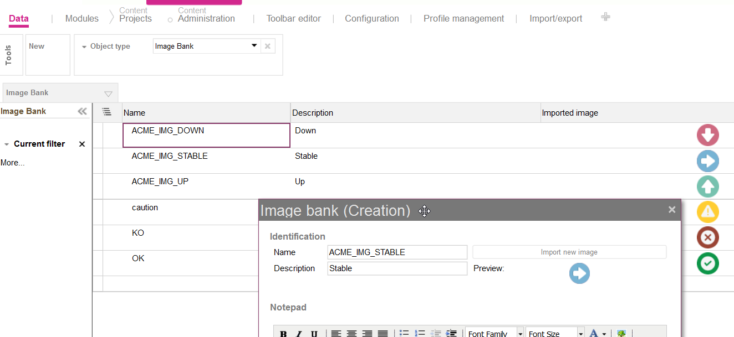
Image bank
Go to Administration > Data > Image bank to import images
These images can be used in symbolic fields or status reports
Image size should preferably be 32 x 32

Slide 78
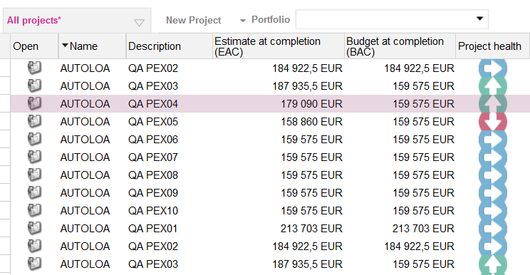
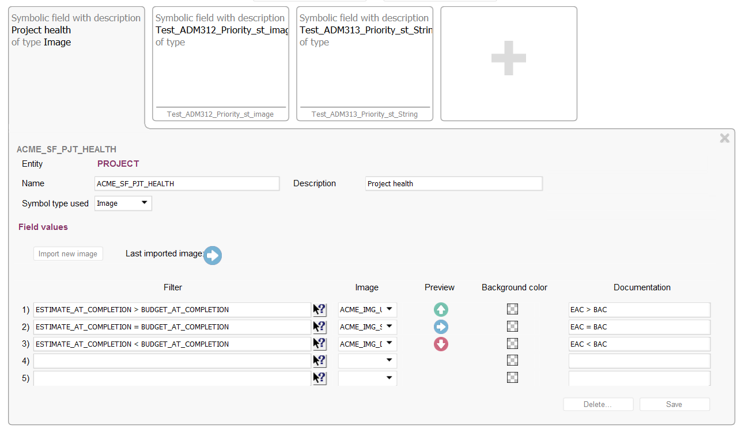
Symbolic fields
You can create symbolic fields and insert them in tables
Choose arrows to represent project health to indicate which direction the project is headed

Slide 79
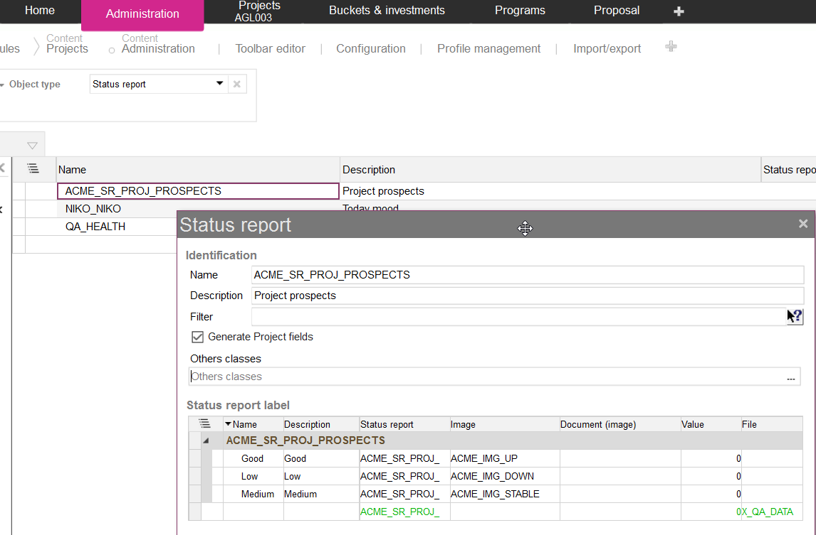
Status report
Can also use the images from the image bank on status reports
Go to Administration > Data > Status report
Check this option to make fields available on projects
Create a status report, define possible values and link images

Slide 80
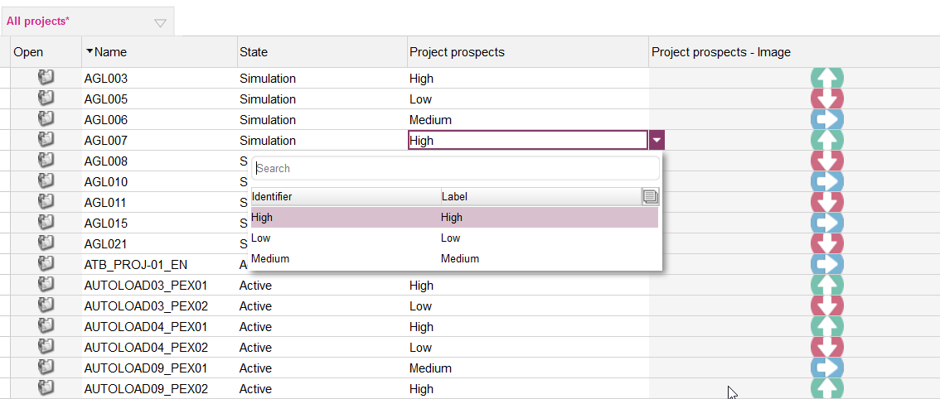
Status reports
2 fields are generated for each status report: one entry field, one display field
Pick a value in the list, the image is updated accordingly

Slide 81
Indicators - Scenario
Scenario
For visual purposes, the image management works perfectly! I would, however, like to see more quantitative metrics (ie. Net Present Value, Payback Period etc) – either using the ones defined by Planisware or by creating custom ones.

Slide 82
Indicators - Scenario
Scenario
For visual purposes, the image management works perfectly! I would, however, like to see more quantitative metrics (ie. Net Present Value, Payback Period etc) – either using the ones defined by Planisware or by creating custom ones.
1
2
Analysis
Manage indicators to view cost metrics at a glance on the dashboard.
How to break down the situation: 1. Planisware delivers with a set of predefined indicators based on frequently used metrics.
2. Using the pre-defined indicators, you may create new custom indicators.

Slide 83
Indicators
Introduction
Classic indicators
Managing indicators

Slide 84
Introduction
3 main types of indicators are delivered by default when restoring a Planisware Processes dpe:
A set of classic indicators based on popular metrics
All those indicators are delivered within an indicator bar
A set of indicators generated during the start of the intranet and based on a limited list of financial KPI
When a new P&L equation recall an output linked to those KPI it is automatically linked to those indicators
A set of indicators generated during the start of the intranet and based on profit and loss outputs
All equations of the profit and loss with an output automatically trigger the creation of an indicator

Slide 85
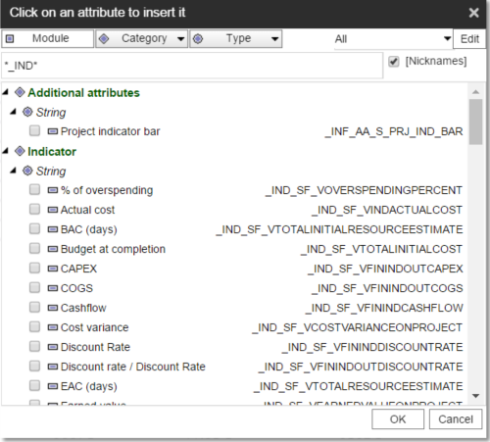
Classic Indicators
Classic indicators may be found on the project level with the keyword in the technical name “_IND”.
These may include budget at completion, discount rate, net present value, payback period, total investment etc

Slide 86
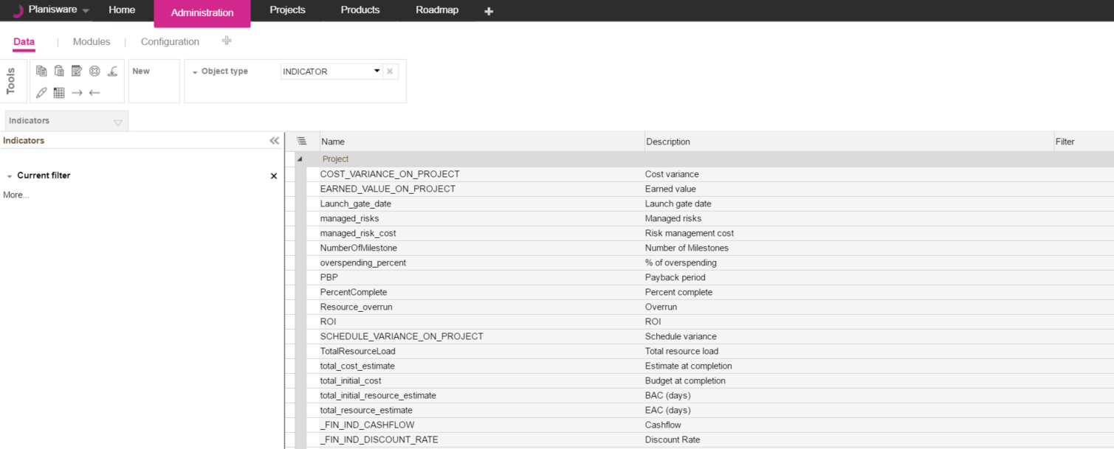
Manage Indicators
Indicators are listed in the Administration module, page Data. Select object type Indicators
Click on New from the toolbar to create custom indicators.

Slide 87
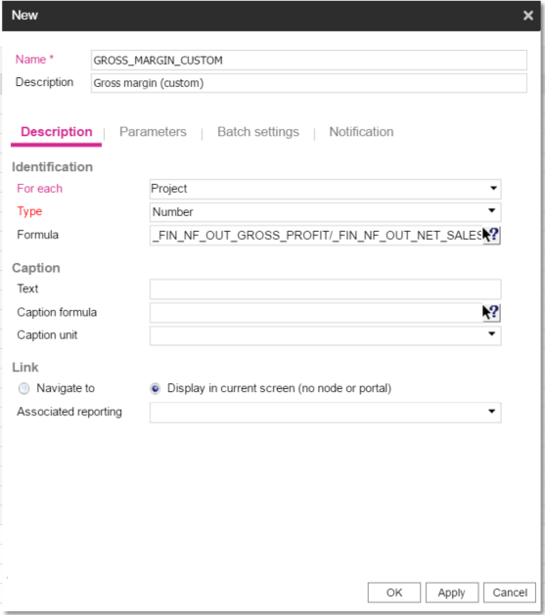
New Indicators
1
Give your indicator an appropriate Name and Description
Name – Check with your admin to see if you have a naming convention to use
Description - Use a description that makes it easy for end users to understand
Define the iteration on the indicator (eg. Project, Activity, Resource, User defined portfolios)
Select the correct type of the indicator (eg. Number, string, date, cost etc.)
If you would like to define a custom indicator, you may define the formula using a combination of Planisware indicators (eg. Gross profit, net sales, budget at completion etc.)
1
2
3
4
2
3
4

Slide 88
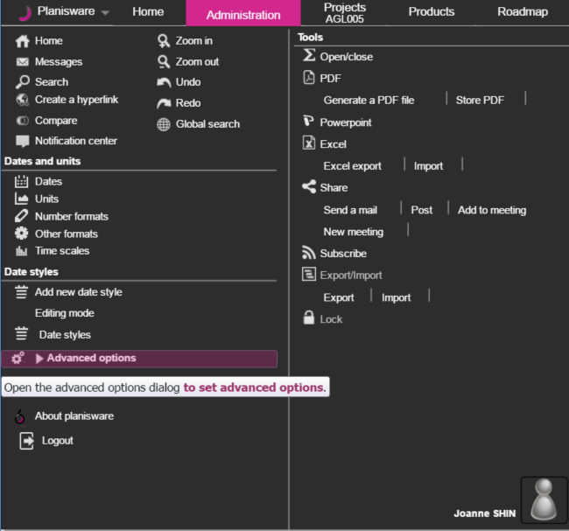
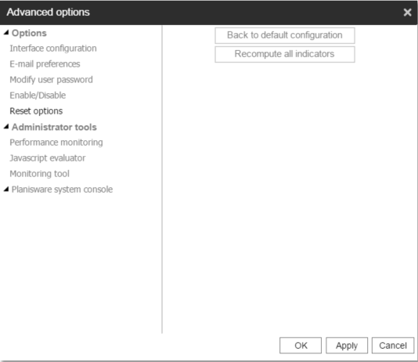
Recomputing Indicators
Indicators are not refreshed automatically – you will need to recompute for your new data to show.
1
4
Click on the Planisware main menu.
Click on Advanced options
From the new popup, click on Reset options.
Click on Recompute all indicators.
Click on Ok to close the popup.
1
3
2
3
2
4
5
5

Slide 89
Indicator bars - Scenario
Scenario
Great! We’ve got some indicators we can work with. Rather than adding them individually on the project list though, can I view them nicely grouped somewhere within a report?

Slide 90
Indicator bars - Scenario
Scenario
Great! We’ve got some indicators we can work with. Rather than adding them individually on the project list though, can I view them nicely grouped somewhere within a report?
Analysis
By default, Planisware is delivered with a set of predefined indicator bars that can be deactivated. Indicators bars are designed to be displayed on dashboards based on Portal model and on Profit & Loss spreadsheets.

Slide 91
Indicator bars
Creating indicator bar
Defining default indicator bar
Deactivating indicator bar

Slide 92
Creating a new indicator bar
To create a new indicator bar:
Navigate to Administration Module, page configuration
Select for which object class indicator bar is created
Open section Indicator bar
Click on + to create a new indicator bar
Create a new indicator bar by setting its name
Define its content by going to its advanced properties
Select indicator on the right and click Insert

Slide 93
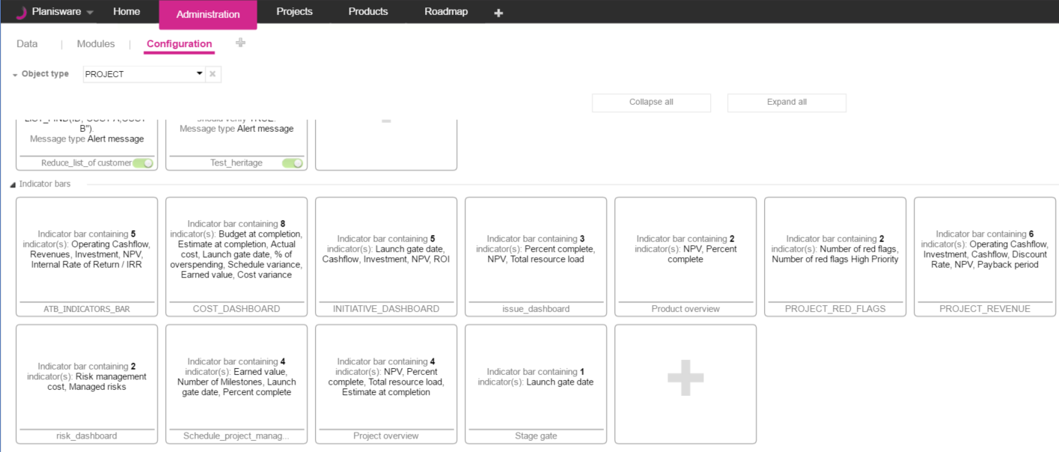
Creating a new indicator bar
1
2
3
4

Slide 94
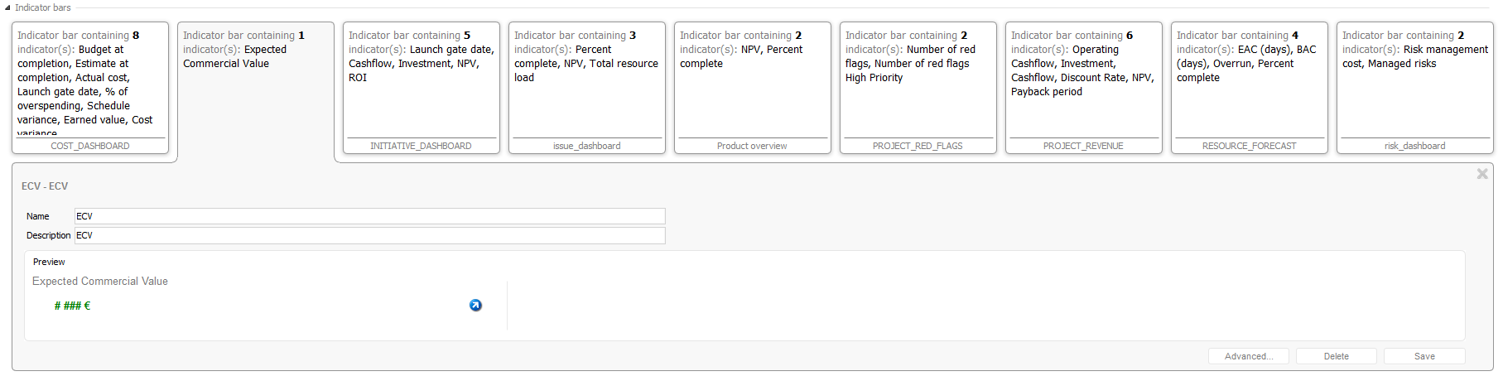
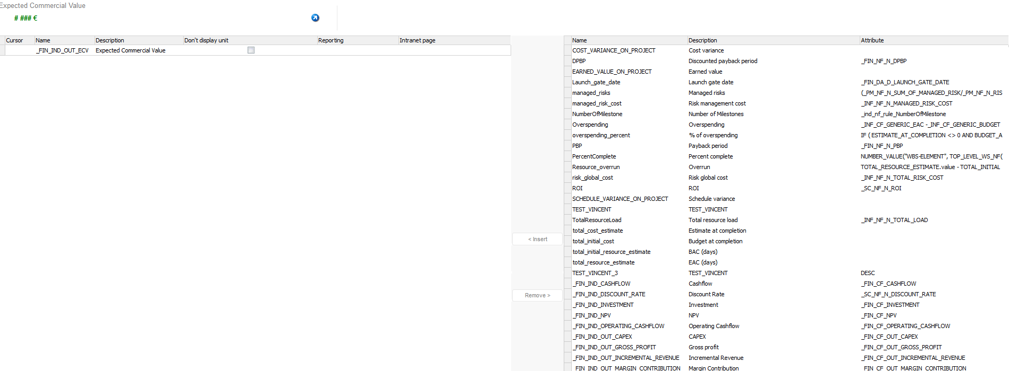
Creating a new indicator bar
5
6
Indicator bar overview
7
Insert indicator in the indicator bar
List of indicators

Slide 95
Defining default bar
To define default bar on the page Dashboard of project management module:
Navigate to Administration module
Page Modules
Click thumbnail of Project management module
Click on button Content
Open the thumbnail of the page Dashboard Summary
Set a default indicator bar

Slide 96

Deactivating indicator bar
Indicator bars delivered by Planisware can be hidden to the final user :
Navigate to Administration > Data. Select object type Indicator bar.
Unselect Is active ? attribute on the indicator bar to be hidden

Slide 97

Deactivating indicator bar (2/2)
The deactivated indicator bars can no longer be selected in the dashboards

Slide 98
Attribute chooser style - Scenario
Scenario
Users who perform basic actions in the project module are complaining that the number of options they see is overwhelming. Can we find a way to restrict what attributes they see?

Slide 99
Attribute chooser style - Scenario
Scenario
Users who perform basic actions in the project module are complaining that the number of options they see is overwhelming. Can we find a way to restrict what attributes they see?
Analysis
By default, the list of attributes to insert on a class can be overwhelming. For example, users may want to simply know when a project was created and items related to their job function. To limit this list to only the relevant attributes, you can define a style in the attribute chooser.

Slide 100
Attribute Chooser Style

Slide 101


Attribute chooser style
1. Create a new attribute chooser style
2. Select the attributes you want to display
Use “access rights” to share the style
3. When the style is applied, the attribute list is filtered
Tip : To set it as default use the template user

Slide 102
Exercise
Create a new personal style for the project attributes:
Name = XX project attributes
Add your XX_UA_S_DIFFICULTY_LEVEL
Export the style to some other users
Verify from the Project page that when picking your style, only that attribute shows

Slide 103
L1 style - Scenario
Scenario
I want to be able to save the changes that I made to the view of the projects, and share this style with other users.
Analysis

Slide 104
L1 style - Scenario
Scenario
I want to be able to save the changes that I made to the view of the projects, and share this style with other users.
Analysis
By default the list of attributes you see on your screen may not align with your preferences. We discussed adding different attributes and fields according to your needs. To save this list of only relevant attributes, along with additional fields and filters, you can define a L1 style.

Slide 105
L1 Style

Slide 106

Define a L1 style
On the homepage of projects, return to the default style
Insert or remove columns
Once the layout is ready save the style as a user style

Slide 107

Apply and share a L1 style
Set access rights to share with other users and groups
Tip! As a Template user, make the style default. It will apply to all users of the profile

Slide 108

Text Keys - Scenario
Scenario
Nicely done! I also want to change titles of modules and some attributes to make the terminology seen on the screen more user friendly. Can this be done?
Analysis

Slide 109
Text Keys - Scenario
Scenario
Nicely done! I also want to change titles of modules and some attributes to make the terminology seen on the screen more user friendly. Can this be done?
Analysis
You can modify what labels the end-users will see in the interface, by applying modifications to the standard text keys. If a label needs to be modified, it can be modified centrally, in the corresponding text key, and all the labels using that text key are modified accordingly.

Slide 110
Text Keys

Slide 111
Introduction
Used to modify what labels the end-users will see in the interface
Modify existing Standard text keys for standard labels delivered by Planisware
Or create customized text keys for company specific labels
Recommended to use text keys for description of objects

Slide 112

Text Keys
Is replacement active?
Column indicates if text key is replacing a standard text key and if the replacement is activated or not

Slide 113

Creating Text Keys
Navigate to Administration > Data > TEXT_KEYS
1. Create a new text key
2. Name is mandatory and should not contain spaces. Select a parent key, if necessary
3. Enter the label for each language used in your system, in the appropriate zones; e.g. English label in the English zone
4. Click OK to save creation and close the dialog

Slide 114

Modifying Text Keys
To modify text keys:
Double-click on the line of a text key. The Text Keys (Modification) dialog is displayed.
Modify your data.
Check the Is active? box to activate the modification.
If you do not check the Is replacement active? box, it is deactivated by default . To activate it, double-click on the icon in the “Is replacement active?” column. The icon becomes green.
Notes:
Change this screenshot to adjust for creating a text key to replace the name for project module

Slide 115

Using Text Keys
By default descriptions are used for labels in the interface
Can be entered in most Description fields
Syntax: #@<text_key_identifier>, or “Name” column of text key

Slide 116
Toolbar editor

Slide 117
Toolbar editor - Scenario
Scenario
All these toolbars on Planisware seem helpful but some users see unnecessary tools that they don’t use or they would like to
Analysis
You can do this easily using the toolbar editor to hide buttons directly on the toolbar.

Slide 118

Accessing the Feature
To create a new toolbar:
Open the Administration module.
Add the Toolbar Editor page.
Select the report you want to create a toolbar for.
The list displays only the reports of the selected module for which there is no existing toolbar yet.
Select the module of the report you want to create a toolbar for.

Slide 119

Adding Existing Tools
To add an already existing button, click the Add button corresponding to this button.
To add a tool to the toolbar, click the Icon/Button/Toggle/Menu/
Field button.

Slide 120

Adding Existing Tools
The tool is added to the toolbar.
A yellow dot is displayed next to the added tool. It indicates that the toolbar has not been saved yet.
To cancel adding a tool, click the Remove button corresponding to this tool.
A dot is also displayed in the list to indicate the tool that has been added to the toolbar.

Slide 121

Removing Tools from Toolbar
Double click on the tool that you would like to remove from the toolbar.
Click on Remove from toolbar to delete the tool from the toolbar.

Slide 122




Unfolded/folded toolbar (V6.2)
With V6.2, same toolbars may be unfolded or folded.
Double click on the tool that you would like to show in the toolbar.
Check true for either or both to display in the unfolded and/or folded toolbar.

Slide 123


Editing Items of the Toolbar
To edit items:
Open the Administration module.
Add the IHM Toolbar GUI page.
Select the module and the report of the toolbar that you want to modify.
Click the dot next to the item that you want to modify.
Click the Edit tool menu entry. The item attribute sheet is displayed.
Modify the data.
Click Save as new.

Slide 124
E-learning

Slide 125
E-Learning - Scenario
Scenario
I can’t handle all the questions that my end users are sending over to me. Do you have any relevant documentation that can be easily searchable?
Analysis
Training materials and relevant documentation to Planisware are accessed via the E-Learning. Documents are presented via slide decks, videos, and white papers. Company specific E-learning material can be added on top of the standard E-learning material provided by Planisware.

Slide 126

E-learning for a Module 1/2
On each page of Planisware Processes, you have access to the E-learning.
The E-learning documents available correspond to the current module.
1
2
3
Click
A window with the E-learning documents relevant to the module is displayed.
Click to open.
1
2
3
© 2018 Planisware
126

Slide 127

E-learning for a Module 2/2
1
2
3
1
Click the Add module button.
Click thumbnail.
Click on E-learning to open.
2
3
© 2018 Planisware
127

Slide 128


Access E-learning
Quickly learn about more features using easily accessible training documents and videos
Use the search bar to look up training materials relevant to the topic you are interested in, i.e. tool bar

Slide 129
Adding a Document to the E-learning
To add a document to the E-learning:
Open to the Administration module.
Add the Modules page.
Click the thumbnail of a module.
Click the E-learning button.

Slide 130


Adding a Document to the E-learning
The list of the E-learning subjects for the selected module is displayed.
If there is no e-learning subject yet, create a new one (level 1):
Click New Subject.
Enter only a Name, a Description and select related modules.
Click OK. A new E-learning subject is created.

Slide 131

Adding a Document to the E-learning
To add a document belonging to the new e-learning subject (level 2):
Click New Subject. The E-learning subject dialog is displayed.
The newly created e-learning subject is displayed in the list. No level is defined yet.

Slide 132

Adding a Document to the E-learning
Enter a Name (mandatory) and a Description, and select related modules.
Select the created E-learning subject.
Choose between Slide deck, Video, White paper, URL, and Planisware Tour.
Select the document that you want to add.
Click OK. The document is added to the e-learning.

Slide 133

Meet Ajay, the Head of Usability
Styles
Colors and Images
With so much data coming in, we need to make it more presentable and meaningful!
We need thorough methods to highlight important information!
The number of attributes is overwhelming and I don’t want to see them all the time!
We need to make it easier for our users to navigate the application!
Attribute Chooser Style
Text keys, toolbar, E-learning

Slide 134
Questions

Slide 135
Level 1 Configuration – Protect your data
Security

Slide 136
Agenda (1:30pm – 3:00pm)
Locks
Alerts
User Trace
Data Management Rules
User Profiles
Access Rights

Slide 137
Meet your IT Security Officer

Slide 138

Meet Ivan, the IT Security Officer
Our data is too accessible by every user. This could cause major data management issues.
We would like users to be alerted when making changes to critical data.
The financial team would like access to projects and reports.
We need to force users to use the data we need them to use.
Every users can create projects. We need to restrict the creation to Project Managers.
We would like to have more visibility into changes of certain attributes.
Notes:
Scenario – The company uses the name description combination to organize their projects
The Name of a project is already read-only. The company would like for the Description to also be read-only unless you are an admin just in case an error is made.
Exercise: Create a lock on the description attribute
Scenario – If an admin modifies the project description the company would also like to document changes to the description field.
The notepad field can be used to document these changes
Exercise Create an alert on the creation and modification of the description attribute and change the notepad field to notepad + description
Ivan
Access Rights

Slide 139
Locks
Introduction
Creating locks

Slide 140

Ivan’s first problem…
Our data is too accessible by every user. This could cause major data management issues.

Slide 141

Locks - Scenario
Scenario
Our users are changing the project state after the project has been set to active!! We need to restrict data changes on this attribute so that only Admins can change the value after a project has activated.
Notes:
Needs work

Slide 142
Locks - Scenario
Scenario
1
Our users are changing the project state after the project has been set to active!! We need to restrict data changes on this attribute so that only Admins can change the value after a project has activated.
2
2
Analysis
Locks allow you to lock specific attributes to specific users or in specific situations.
How to break down the situation: Figure out relevant classes and attributes - Project: state
Figure out lock conditions : When is the lock activated?
- Locked when Active for Non Admin When is the lock deactivated?
- Unlocked when state is not Active
1
2
Notes:
Needs work

Slide 143

Introduction
A lock prevents attributes from modification or deletion.
In this example, the project State has been locked and put into read-only mode. The field is highlighted in grey and cannot be modified by a user.

Slide 144

Creating locks
To create a lock:
Click the + button.
Enter a Name and a Description (mandatory).
Select attributes.
Check On deletion to prevent the attribute from deletion.
Check On all modifications to put the attribute into read-only mode. Warning: This flag prevents all objects matching the Filter from being modified at all. This means that no attributes can be modified. It is best to not use this option for performance reasons.
Click Create.

Slide 145
Creating locks for certain users/groups
To lock a field to only certain users or groups:
The Filter will cause this lock to only apply to certain situations.
The formula USER_IN_GROUP(user,group) will return true if the user is in the specified group.
In this case, if we want to lock a field to everyone but administrators, the filter would be:
NOT USER_IN_GROUP($CURRENT_USER,”ADMIN”)

Slide 146
Exercise
Create a lock on your XX_UA_S_DIFFICULTY_LEVEL project attribute and only allow modifications if the current user is listed as the owner of the project.
Name = XX_LO_ DIFFICULTY_LEVEL
Description = XX Difficulty level lock
On modification of the following attributes = XX Difficulty level
Filter = $CURRENT_USER <> OWNER
Test the lock to make sure you can only change the difficulty level on project where you are listed as the owner.

Slide 147
Alerts
Introduction
Creating alerts

Slide 148
Ivan’s second problem…
We would like users to be alerted when making changes to critical data.
Notes:
Scenario – The company uses the name description combination to organize their projects
The Name of a project is already read-only. The company would like for the Description to also be read-only unless you are an admin just in case an error is made.
Exercise: Create a lock on the description attribute
Scenario – If an admin modifies the project description the company would also like to document changes to the description field.
The notepad field can be used to document these changes
Exercise Create an alert on the creation and modification of the description attribute and change the notepad field to notepad + description
Ivan
Access Rights

Slide 149
Alert - Scenario
Scenario
Our users are changing the project state. We need to lock this down.
That lock on the project state is great! We have another attribute, the project description, that we don’t want to lock, but rather ensure it is populated at all times!
1
2
Notes:
Needs work

Slide 150
Alert - Scenario
Scenario
Our users are changing the project state. We need to lock this down.
That lock on the project state is great! We have another attribute, the project description, that we don’t want to lock, but rather ensure it is populated at all times!
1
2
1
2
Analysis
Alerts can do so many things! In this example, we will use an alert to tell the current user they need to have a description if they attempt to delete a description. But we can also alert other users, either through emailing or through notifications.
How to break down the situation: Figure out relevant classes and attributes - Project: description
1
Notes:
Needs work

Slide 151
Alert - Scenario
Scenario
Our users are changing the project state. We need to lock this down.
That lock on the project state is great! We have another attribute, the project description, that we don’t want to lock, but rather ensure it is populated at all times!
1
2
1
2
Analysis
Alerts can do so many things! In this example, we will use an alert to tell the current user they need to have a description if they attempt to delete a description. But we can also alert other users, either through emailing or through notifications.
How to break down the situation: Figure out relevant classes and attributes - Project: description
Determine what needs to be done - description never blank
1
2
Notes:
Needs work

Slide 152

Introduction
With an alert, it is possible, for example, to request the user to fill the Description field of a project when creating it.
When creating a project, a message is displayed if the user has not entered a description.

Slide 153

Creating alerts
To create an alert:
Click the + button.
Enter data. The Name and Label fields are mandatory. The Name cannot contain spaces.

Slide 154
Creating alerts
To create an alert:
Triggers or activation conditions

Slide 155
Creating alerts
To create an alert:
Immediate Message Popup Conditions

Slide 156
Creating alerts
To create an alert:
Persistent Notification

Slide 157
Creating alerts
To create an alert:
Changes in Data

Slide 158

Creating alerts
Select the type of the message.
Click Create.

Slide 159
Exercise
Testing activation Conditions: Alert on project creation the popup message
“Project created” (Use Naming convention XX_PRJ_CREATE)
Alert and prevent on Active State projects the popup message “Can not delete an active project” (XX_PRJ_DELETE)

Slide 160
Exercise
Testing activation Conditions: Alert on project creation the popup message
“Project created” (Use Naming convention XX_PRJ_CREATE)
Alert and prevent on Active State projects the popup message “Can not delete an active project” (XX_PRJ_DELETE)
Testing default Value:
Create 2 date attributes on the project with your 2 initials on the front appended with 1 ) XX_PROJECT_CREATION_DATE 2) XX_LAST_PRJ_DEL_ATTEMPT
Create 1 String attribute on project with your 2 initials on the front appended with 1) XX_ LAST_PRJ_DEL_ATTEMPT_USER
On your project created alert, set XX_PROJECT_CREATION_DATE to $DATE_OF_THE_DAY On your Deletion set XX_LAST_PRJ_DEL_ATTEMPT to today and set XX_ LAST_PRJ_DEL_ATTEMPT_USER to the current user

Slide 161
User trace
Introduction
Creating user traces

Slide 162
Ivan’s third problem…
We would like to have more visibility into changes of certain attributes.
Notes:
Scenario – The company uses the name description combination to organize their projects
The Name of a project is already read-only. The company would like for the Description to also be read-only unless you are an admin just in case an error is made.
Exercise: Create a lock on the description attribute
Scenario – If an admin modifies the project description the company would also like to document changes to the description field.
The notepad field can be used to document these changes
Exercise Create an alert on the creation and modification of the description attribute and change the notepad field to notepad + description
Ivan
Access Rights

Slide 163
User trace - Scenario
Scenario
We have a project whose description field was changed, but we don’t know when or by whom. Is there a way to monitor changes to this field over time?
Notes:
Needs work

Slide 164
User trace - Scenario
Scenario
We have a project whose description field was changed, but we don’t know when or by whom. Is there a way to monitor changes to this field over time?
1
2
Analysis
A user trace gives administrators the ability to see a record of user actions, such as attribute modification. In addition, user traces can be used to monitor object creation and deletion.
How to break down the situation: 1. Figure out relevant classes - Project: description
1
Notes:
Needs work

Slide 165
User trace - Scenario
Scenario
We have a project whose description field was changed, but we don’t know when or by whom. Is there a way to monitor changes to this field over time?
1
2
Analysis
A user trace gives administrators the ability to see a record of user actions, such as attribute modification. In addition, user traces can be used to monitor object creation and deletion.
How to break down the situation: 1. Figure out relevant classes - Project: description Determine what needs to be done - user trace on modification
1
2
Notes:
Needs work

Slide 166

Introduction
User trace enables managers and administrators to track changes on a selected Object type. User traces allow you to define what kind of change concerning the selected object class you want to trace: the creation, the deletion, or the modification of a specific attribute. You can display the user trace log in the Data page, by selecting User traces logs in the Object type filter

Slide 167

Creating user traces
To create an user trace:
Click the + button.
Select the attribute that needs to be traced
Enter a filter on the Class to observe
Click Create.
Check to log all creations of objects in the class
Check to create log entry upon deletion of object

Slide 168


Creating user traces
To create an user trace:
The Information column is filled by the Information pad formula.
The User and Modification Date are logged.
The attribute value before and after the change is logged

Slide 169
Exercise
Create a user trace on your XX_DIFFICULTY_LEVEL project attribute.
Test the trace by modifying the attribute and checking the log in the User traces logs on Administration->Data page.

Slide 170
Data management rules
Introduction
Message type
Creating data management rules

Slide 171
Ivan’s fourth problem…
We need to force users to use the data we need them to use.
Notes:
Scenario – The company uses the name description combination to organize their projects
The Name of a project is already read-only. The company would like for the Description to also be read-only unless you are an admin just in case an error is made.
Exercise: Create a lock on the description attribute
Scenario – If an admin modifies the project description the company would also like to document changes to the description field.
The notepad field can be used to document these changes
Exercise Create an alert on the creation and modification of the description attribute and change the notepad field to notepad + description
Ivan
Access Rights

Slide 172
Data Management Rule - Scenario
Scenario
Our users are selecting the wrong responsibility on projects. We want them to select only level 2 responsibilities!
Notes:
Needs work

Slide 173
Data Management Rule - Scenario
Scenario
Our users are selecting the wrong responsibility on projects. We want them to select only level 2 responsibilities!
1
2
Analysis
Data management rules (DMR) allows you to filter the values available in a list.
How to break down the situation: 1. Figure out relevant classes - Project: Responsibility
1
Notes:
Needs work

Slide 174
Data Management Rule - Scenario
Scenario
Our users are selecting the wrong responsibility on projects. We want them to select only level 2 responsibilities!
1
2
Analysis
Data management rules (DMR) allows you to filter the values available in a list.
How to break down the situation: 1. Figure out relevant classes - Project: Responsibility 2. Determine what needs to be done - DMR on project to filter Responsibility
1
2
Notes:
Needs work

Slide 175


Introduction
Data management rules (DMR), or data consistency rules, allow the administrator to filter the values available in a list. The list of possible values is filtered on all pages (gantt, tables, reports etc…).
Without a Data Management Rule
With a Data Management Rule restricting at level 2 of OBS

Slide 176

Message type
A DMR can also verify the input of a field according to certain rules, to optionally warn the user and even to cancel the input if required.
To do so, select a Message type from the drop-down list.

Slide 177

Creating data management rules
Example 1: Displaying only responsibility level 2 on projects.
Select Projects as Object Type.
To create a DMR:
Click the + button.
Enter a Name (mandatory) and select an Attribute.
Click Save.
Only the responsibilities of level 2 are available.

Slide 178
Examples
Data Autofill DMR that autopopulates desc based on STATE + NAME

Slide 179
User Profiles
Introduction

Slide 180
Ivan’s fifth problem…
The financial team would like access to projects and reports.
Notes:
Scenario – The company uses the name description combination to organize their projects
The Name of a project is already read-only. The company would like for the Description to also be read-only unless you are an admin just in case an error is made.
Exercise: Create a lock on the description attribute
Scenario – If an admin modifies the project description the company would also like to document changes to the description field.
The notepad field can be used to document these changes
Exercise Create an alert on the creation and modification of the description attribute and change the notepad field to notepad + description
Ivan
Access Rights

Slide 181
User Profile - Scenario
Scenario
The financial team would like access to projects and reports.
Notes:
Needs work

Slide 182
User Profile - Scenario
Scenario
The financial team would like access to projects and reports.
1
2
Analysis
User profiles are designed to grant access to modules and functionalities for several users. Profiles are also used to define the default pages and tabs that should be displayed when first connecting to the application.
How to break down the situation: 1. Determine what needs to be done - New user profile 2. Granting Access to Modules and Functionalities
Notes:
Needs work

Slide 183

Introduction
A profile is a user group marked as a profile. A standard user group can still be used to manage access to data.

Slide 184

Creating Profiles
To create a new profile:
Open the Administration module.
Add the Profile Management page.
Click New profile. The Create/Edit profile dialog is displayed.
Enter a profile name and description.
Setting file : if left empty same default settings will be applied for all profiles.
Click OK.

Slide 185

Creating Setting File
Setting files are used to store different set of settings values (for example € as default currency for users in Europe and $ for users in US).
To assign a Setting file:
Enter a name in the Setting file field. The system checks if the common file exists and creates it if necessary. It also creates a global setting file object if necessary (Object type GLOBALSETTING_FILE in Administration > Data).
Note: To delete the global setting file object, clear the Setting file field. The global setting file object is deleted but the linked common file is not deleted.

Slide 186

Updating Profiles
To update a profile:
Open the Administration module.
Add the Profile management page.
In the table, click on the name of the profile you want to update. The Create/Edit profile dialog is displayed.
Update your data.
Click OK. The profile is updated.
Parameters and functionalities granted to the profile.

Slide 187
Access Rights
Introduction

Slide 188
Ivan’s final problem…
Every users can create projects. We need to restrict the creation to Project Managers.
Notes:
Scenario – The company uses the name description combination to organize their projects
The Name of a project is already read-only. The company would like for the Description to also be read-only unless you are an admin just in case an error is made.
Exercise: Create a lock on the description attribute
Scenario – If an admin modifies the project description the company would also like to document changes to the description field.
The notepad field can be used to document these changes
Exercise Create an alert on the creation and modification of the description attribute and change the notepad field to notepad + description
Ivan
Access Rights

Slide 189
Access Right - Scenario
Scenario
Every users can create projects. We need to restrict the creation to Project Managers.
Notes:
Needs work

Slide 190
Access Rights - Scenario
Scenario
Every users can create projects. We need to restrict the creation to Project Managers.
2
1
Analysis
Once a profile has been created, the administrator can define the modules and functionalities to which the profile has access.
How to break down the situation: 1. Figure out relevant profiles -Profile: Every profiles besides PM
2. Determine what needs to be done -Revert Project Creation functionality
1
2
Notes:
Needs work

Slide 191
Access Rights - Scenario
Scenario
Every users can create projects. We need to restrict the creation to Project Managers.
2
1
Analysis
Once a profile has been created, the administrator can define the modules and functionalities to which the profile has access.
How to break down the situation: 1. Figure out relevant profiles -Profile: Every profiles besides PM
2. Determine what needs to be done -Revert Project Creation functionality
1
2
Notes:
Needs work

Slide 192

Introduction
Access to Modules and Functionalities can easily be managed through the Profile Management page.

Slide 193


Granting Access to Modules
To grant access to modules:
In the Administration module, on the Profile management page, click the Modules shortcut. The matrix of profiles and modules is displayed.
The module is selected.
The module is deselected.
Note: By default, the Home module is always selected and displayed for each profile.

Slide 194

Granting Access to Modules
It is also possible to grant access to modules in the Administration module, on the Modules page:
Click on the thumbnail of a module.
In the User group field, update the list of the user groups.
Click Save.

Slide 195

Granting Access to Functionalities
To grant access to functionalities such as project creation or shortcuts management :
In the Administration module, on the Profile management page, click the Functionalities shortcut. The list of the profiles and functionalities is displayed.
The functionality is selected.
The functionality is deselected.

Slide 196
Granting Access to Functionalities
Functionality
Idea campaign manager | Allows users to create idea campaigns.
Monte-Carlo-Simulation | Allows users to access to the Monte-Carlo simulation
Project creation | Allows users to create new projects.
Project template creation | Allows users to create new project templates.
Scorecard scoring and template management | Allows users to define scorecards
Scoring | Allows users to enter score on scorecards
Shortcuts management | Allows users to edit the shortcuts in the Style Manager menu.
Stage & Gate | Gives users access to the Stage & Gate page in the Project management module.
TimeCard | Gives users access to the TimeCard pages in the Team member module.
Tools for simulations | Allows users to create a portfolio simulation in the Projects module.

Slide 197

Granting Access to Parameters
To grant access to parameters:
In the Administration module, on the Profile management page, click the Parameters shortcut. The list of the profiles and parameters is displayed.
The parameter is selected.
The parameter is deselected.

Slide 198
Granting Access to Parameters
Parameter | If the parameter is allowed in the Style Manager menu, the user can
Hide attribute profile tools | Not use the 'New' and the 'Edit' buttons in the Attribute chooser dialog
Limit access to folder changes within OPX2 IS to the following list of users or groups | Add styles as shortcuts
Limit access to style export within OPX2 IS to the following list of users or groups | Export styles
Limit columns organization of tables within OPX2 IS to the following list of users or groups | Use the Organize Columns button
Limit style updates within OPX2 IS to the following list of users or groups | Update styles
Limit the access to advanced chart parameters within OPX2 IS to the following list of users or groups | Use the Change chart properties button

Slide 199

Defining Default User Flags
When creating a new user or assigning a user to profile, the user will inherit from the values defined here.
To define the default user flags:
In the Administration module, on the Profile management page, click the User flags shortcut. The list of the profiles and parameters is displayed.
The flag is activated for the users having this profile.
The flag is deactivated for the users having this profile.
The flag is not relevant for the profile.
Note: It is possible to change the flags for a particular user.
Note: It is still possible to manually modify the user flags after the creation of the user or after assigning a profile. This will not update existing user rights.

Slide 200
ANNEX
Introduction

Slide 201


Creating data management rules
Example 2: Displaying only the OBS elements belonging to the selected responsibility (in this example, O3).
Select Activity as Object Type.
To create a DMR:
Click the + button.
Click Create.
With the DMR, only the OBS elements belonging to O3 are available.

Slide 202

Creating data management rules
If you create a DMR on a plain string attribute, to turn a field into a drop-down list in pop-ups, use the formula VALUE IN().

Slide 203
Meet Ivan, the IT Security Officer
Alerts
Our data is too accessible by every user. This could cause major data management issues.
We would like users to be alerted when making changes to critical data.
Locks
Access rights
The financial team would like access to projects and reports.
We need to force users to use the data we need them to use.
Data management rules
User profiles
User Trace
Every users can create projects. We need to restrict the creation to Project Managers.
We would like to have more visibility into changes of certain attributes.
Notes:
Scenario – The company uses the name description combination to organize their projects
The Name of a project is already read-only. The company would like for the Description to also be read-only unless you are an admin just in case an error is made.
Exercise: Create a lock on the description attribute
Scenario – If an admin modifies the project description the company would also like to document changes to the description field.
The notepad field can be used to document these changes
Exercise Create an alert on the creation and modification of the description attribute and change the notepad field to notepad + description
Ivan
Access Rights

Slide 204
Questions

Slide 205
Level 1 Configuration – Process and tools

Slide 206
Agenda (3:00pm – 5:00pm)
Configurable Reports
Status Reports
Workflows
Import Export
Code Generator

Slide 207
Management

Slide 208

Meet your manager, Silvia
We need a traceable process to assign responsibility for a sequence of different activities in a project!
Our team has a variety of projects to keep track of and we lack effective ways to manage their different statuses!
We need to find ways to make data entry more automated and efficient!
The layout of our forms need to be updated!
We need an easy way to import data from/export data to Excel!

Slide 209
Configurable reports

Slide 210
Configurable reports
Scenario
As our company is expanding globally, we need to keep track of more attributes. Some of our reports will need updating, like the adding the field “Country” to the Project form. What is the easiest way to do this?

Slide 211
Configurable reports
Scenario
As our company is expanding globally, we need to keep track of more attributes. Some of our reports will need updating, like the adding the field “Country” to the Project form. What is the easiest way to do this?
Analysis
Use the form builder to get the desired layout and fields by updating an existing report.
How to break down the situation: 1. Copy the project form by creating a configurable report. 2. Create a new color rule with an icon or symbol and color that can be viewed on the Gantt screen

Slide 212

Create the Configurable report
To insert the new attribute in the project properties form, go to Administration > Configuration > Configurable report
Select the report to update and click “Create”
Click “Create” to duplicate the report

Slide 213

Create the Configurable report
A copy of the form is generated, ready to be modified
Reporting toolbar : to align, color, copy, paste…
Decide which tab to use :
- the original one,
- the new one,
- or if it should be hidden
Then publish it
Available attributes and widgets : drag & drop to add them to the form

Slide 214

Attribute Properties
Attribute Selector
Positioning
Enter a list of values – Multi Selection enabled
Field input is mandatory
Input mode -> not often changed
Entity Displayed
Value choice filter -> Filters on the entities displayed

Slide 215


Update project properties form
Drag & drop your field
Click this tool to insert : field label + field itself
Result : dropped field can be adjusted like input arrow, simple input…
Drag & drop field "Associated country" to the form

Slide 216




Update project properties form
Final result after publishing it
Form builder: "Associated country" is now displayed
Original: no "Associated country"

Slide 217
Status Reports

Slide 218

Status Reports
Scenario
We need a quick view of the status on different project that can be changed by different users. Can we have meaningful symbols so users can get the best information

Slide 219
Status reports
Scenario
We need a universal method of defining the status on different projects that can be changed by different users. Can we have meaningful symbols to along with this status information as well?
Analysis
It is possible to define some common report values on projects. Those report statuses allow users to share a common list of statuses on their projects.
How to break down the situation: 1. Create a status report
2. Create a corresponding status report label to use on Walls.
3. Select images or documents to link on these reports.

Slide 220

Introduction
These statuses can be displayed on the project wall, on the project list or on the user wall.
On the project list, images that are linked to the latest labels of the status report can be displayed.

Slide 221


Creating Status Reports and Labels
To create a status report:
Open the Administration module.
Add the Data page.
In the Object type field, select Status report.
Click the New button. The Status report dialog is displayed.
Enter the identification of the status report.
Note: In the Filter box, if you enter $CURRENT_PAGE_OBJECT_ID=ID, this status report is created only from the user wall.

Slide 222

Creating Status Reports and Labels
If you check Generate Project fields:
The created status report appears in the filters on the Project Wall and on the user wall.
Click OK. The new status is created.
Check this option to make fields available on the projects list
Once intranet has been restarted, columns can be inserted in the table on the Project list to display the latest update of the status. Users can modify the text and select another status.

Slide 223
Creating Status Reports and Labels
Upon status creation, Planisware automatically generates:
Filters in the different walls
Wall in Project module and User Wall in Home
Indicators at the project level:
Current and last value
Trend
Last user who updated the status
Last update date

Slide 224
Creating Status Reports and Labels
In a project table :
If you modify the status less than 24 hours after its creation, the last status is updated.
If someone other than the creator of the status updates the status, this creates a new status.

Slide 225

Creating Status Reports and Labels
To create labels linked to the status report, open the Administration module.
Add the Data page.
In the Object type field, select Status report label.
Click the New button. The Status report dialog is displayed.
Enter a name.
Select the status report, you want this label to be linked to.
Select an image or a Document (image).
Click OK. A line is created for this label in the table.

Slide 226


Posting a Status on the Project Wall
Open a project.
Add the Project Wall page.
Click the arrow next to the Post button. A drop-down menu is displayed.
Select the Status report that you want to use. The Share a status report dialog is displayed.
Enter a post content (mandatory).
Select a label linked to the selected status report.
You can add a document.
Click Post.

Slide 227


Displaying Status on the User Wall
The status report displayed on the User wall.
On the user wall: successive status of different projects are displayed.
Possible to display only the most recent statuses.

Slide 228


Displaying Status Trend
The status report displayed on the User wall.

Slide 229
Exercise
Create a new project status:
Name = XX_PROJECT_STATUS
Description = XX Project status
Generate the project fields
Labels are: Green, Yellow, Red
Verify you can post a new status on your project wall.
Verify the status fields for the project are set according to the status you created
Verify that the trend indicator works

Slide 230
Creating workflows

Slide 231
Workflows
Scenario
We need a traceable process to assign responsibility for a sequence of different activities in a project.

Slide 232
Workflows
Scenario
Simple workflows allow you to quickly set up a process in which different responsible parties can be assigned to each step.
Analysis
Simple workflows allow you to quickly set up a process in which different responsible parties can be assigned to each step.
How to break down the situation: 1. depends on the workflow!

Slide 233

How to create new workflows
Navigate to Administration > Configuration. In the object type, select the object type you want to create the new workflows on
For our example, choose Activity
In the Simple workflow grouping click on the + to access the new workflow attribute sheet.

Slide 234

Workflow attribute sheet
Enter a Name and a Description for the workflow.
By default newly created workflows are deactivated.
It is possible to activate them once they are built with all steps.
It is possible to enter a Filter so the workflow is available only on object types matching the filter condition.
The Enter the workflow only once option means that once last action has been executed then workflow will not be available anymore for the object.
If this option is unchecked then object will reenter the workflow endlessly.
It is possible to select a Report.
The link available in the ‘Responsible’ and/or ‘Informed’ user e-mail or message will point at a popup with the report set and its corresponding actions.

Slide 235

Workflow attribute sheet
Once created, you can access more options on the Workflow attribute sheet
By default the Simple workflow is not active. Activate the workflow with the switch button.
Here is the preview of the steps and the actions of the workflow.
Edit the Steps and actions of the created workflow.
It is possible to copy an existing simple workflow by clicking on Duplicate.
Save modifications applied on the attribute sheet.
Delete the current Simple workflow

Slide 236

Build your workflow
Click on Advanced to open the simple workflow in an instance
Retrieve all information available on the Simple workflow attribute sheet in the Definition section.
Start building the simple workflow in the Steps section.
By default you get the Start step and the first step of the Simple workflow.
The Start step is not modifiable/removable.
To edit the first step, click on it to get all options in a right panel.

Slide 237

Build your workflow
Create the first step
Enter a label for the Step.
Specify Responsible user(s) for the Step: the user(s) in charge of executing the action.
The list of Responsible is plugged on the roles.
When doing modifications on the current Step you need to save them.
Click on the + to add a new step.
Specify Informed user(s): the user(s) receiving emails when action is executed.
The list of Informed is plugged on the roles.

Slide 238

Build your workflow
Create action linked to the step by clicking the shape
Modify the label of the action. This will be the label of the workflow button.
Define an activation condition so the action will be executable only if the object on which the workflow is defined matches the condition.
Enter a message when action is executed on an object that does not match the condition.
It is possible to set a value on an attribute as soon as the action is executed.
Do not forget to save all modifications.

Slide 239

Activate and Publish
Once the complete workflow has been built, it must be activated and published to work
Any modification requires save and publish again
Workflow will not be applied on objects created before activation and publication of the workflow
All active workflows are automatically published on startup of the Intranet server
It is not possible to publish an inactive workflow

Slide 240
More about workflows
Drag a step and drop it over another to create new nodes
Cannot create cycles
Once you’ve entered the first step of the workflow a Back to button will be available to get the object back to a previous step of the workflow
Reports can be set on the workflow

Slide 241


Workflow Example

Slide 242
Import Export

Slide 243
Import Export
Scenario
Our team has many excel spreadsheets with information like project lists but I don’t want to have to enter all this information manually in Planisware all over again. Can we have an efficient way to do this, especially if we have to do this multiple times in the future?

Slide 244
Import Export
Scenario
Our team has information about the I don’t want to have to enter all this information manually in excel all over again. Can we have an efficient way to do this, especially if we have to do this multiple times in the future?
Analysis
Import-export feature is available in configuration level 1. This interface has been designed to facilitate the import and the export of data from/to an external file (.csv or json file) from/to a Planisware table.
How to break down the situation: 1. Define a mapping for the columns that need to be exported using an import/export format
2. Define a new import/export target which allows the system to export the data from a Planisware table to the target .csv file

Slide 245

Define import export format
Go to Administration > Import-export format to define a new export format
Select the object class to export
Tip! pick a pre-defined user style from the list to populate the format

Slide 246

Define target and export data
Define a new import/export target, then click “Export” to generate the csv file in the specified folder
Pick the format in the list
Set the path of the exported file
Click “Export” to generate the file
Log of the previous exports
© 2018 Planisware

Slide 247
Code generator

Slide 248
Code generator
Scenario
Is there a way to automatically name some tasks so users who create them don’t need to come up with names for them?

Slide 249
Code generator
Scenario
Is there a way to automatically name some tasks so users who create them don’t need to come up with names for them?
Analysis
You can now create sequence generated code and allocate this value, as a default value, whenever an object is created.
How to break down the situation: 1. Create the code generator on the task class 2. Update the Attributes default value of the task class to use this newly created code

Slide 250


Sequence generated code
Navigate to Administration > Configuration. Select the object type you want to create the code on. Press the plus icon under the Sequence generated code to create a new one.
Enter a Name for the Sequence generated code
1
Enter the desired formula in the field Code generation formula
Under Attribute settings, change the default value for the Name attribute. Allocate code generator as default value (uppercase and between "")
2

Slide 251



Sequence generated code
When you create a new task, code generator is displayed in NAME field
2- Sequence generated code is also visible in table (switch to "Input mode)
Once the object is created, sequence generates code
1- Once the object is created (click "Apply"), sequence automatically generates its code for the name

Slide 252
Meet your manager, Silvia
Workflow
Status Reports
We need a traceable process to assign responsibility for a sequence of different activities in a project!
Our team has a variety of projects to keep track of and we lack effective ways to manage their different statuses!
We need to find ways to make data entry more automated and efficient!
The layout of our forms need to be updated!
We need an easy way to import data from/export data to Excel!
Code Generator
Configurable Reports
Import/Export

Slide 253
Questions

Slide 254
Download training material
https://l1training.planisware.com/sat0/l1training.pptx
https://l1training.planisware.com/sat0/nf.pdf
(need to log in with your username/password before downloading)

